Slide 1
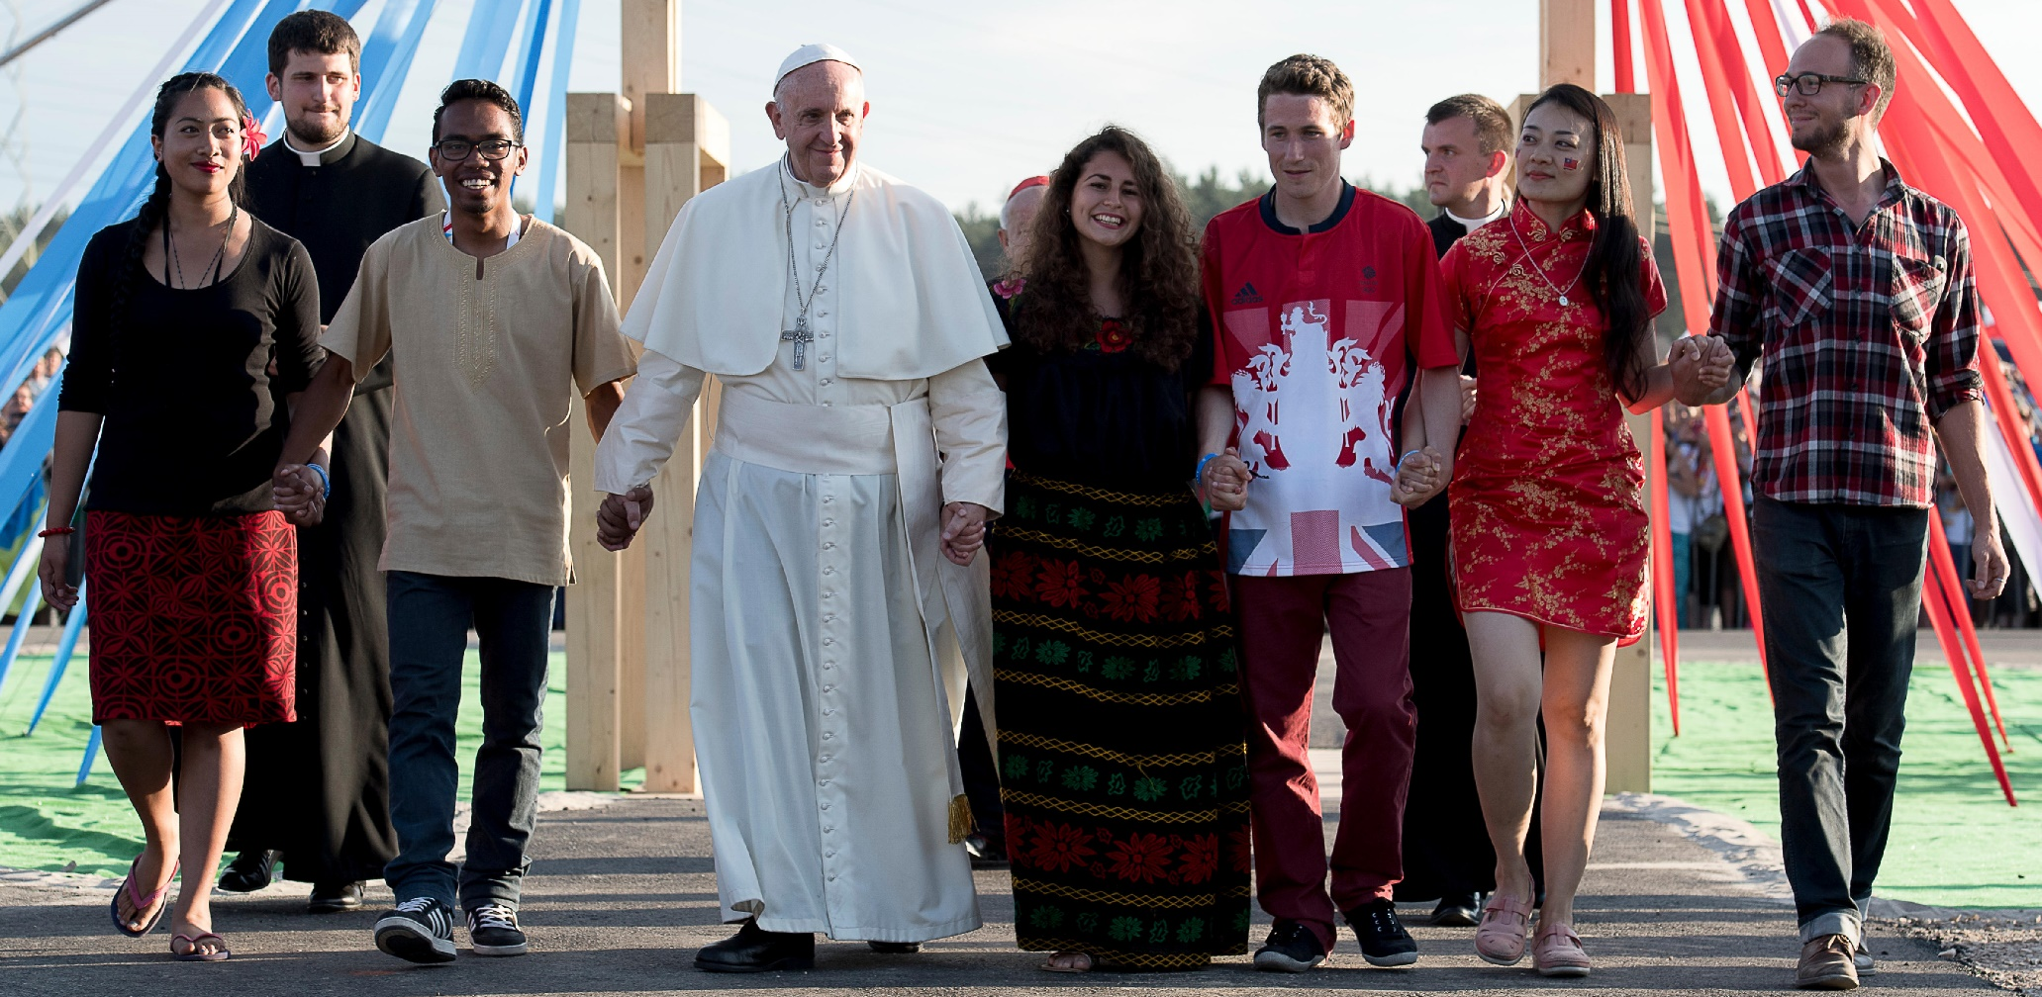
One Family in Mission

Slide 2
The Mission of the Church
In my Father’s House there are many rooms.”
John 14:2
Examine the picture and quote from St John’s Gospel. Try to write down at least two answers for each of the following questions:
What do you see?
What do you think?
What do you wonder?

Slide 3
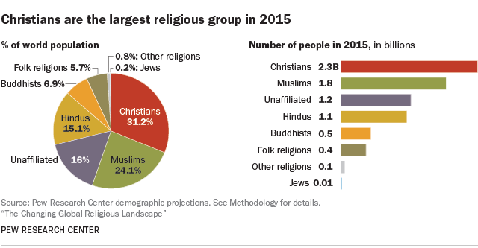
The Mission of the Church
Our world is made up of many different people who have distinctive colours, creeds, nationalities and religions. Christianity is the world’s biggest religion with over 2.2 billion followers who hail from all over the world. Christianity is practised on every continent of the world by people from different countries who all follow this religion and have the same essential beliefs (although there are different denominations within it).
Task A
Create your own chart of the world religions pie chart into your jotter.

Slide 4
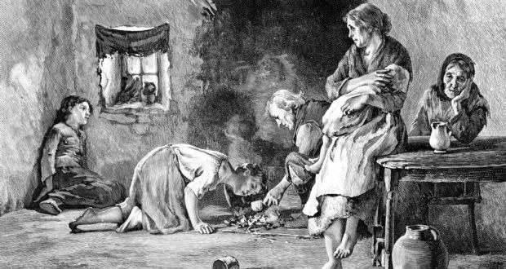
The Mission of the Church
The Catholic community in Scotland grew steadily throughout the 19th century as a result of economic hardship in another country. Namely the Great Hunger in Ireland where the potato crop, on which most of the Irish lower class depended for their nutrition, failed resulting in a disaster in the land.

Slide 5
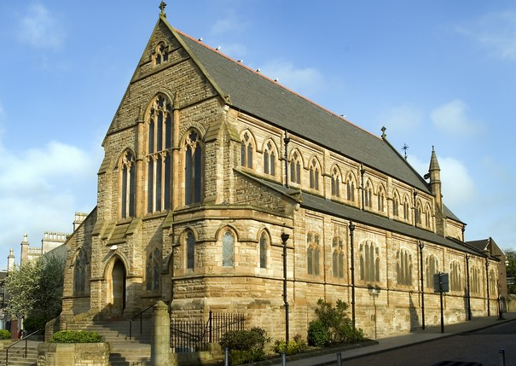
The Mission of the Church
Much of the population emigrated to America, Canada, Australia, England and Scotland. The Catholic community in Scotland relied heavily upon the missionary work of priests, mostly from Ireland, to re-energise the Catholic Faith in Scotland and to help it grow. We were, in fact, a missionary country, who relied on Catholics from abroad to help us build up the capacity to manage our own Catholic churches and schools.
St Patrick’s Church in Coatbridge, for example, was founded to meet the needs of the majority immigrant Irish community.

Slide 6
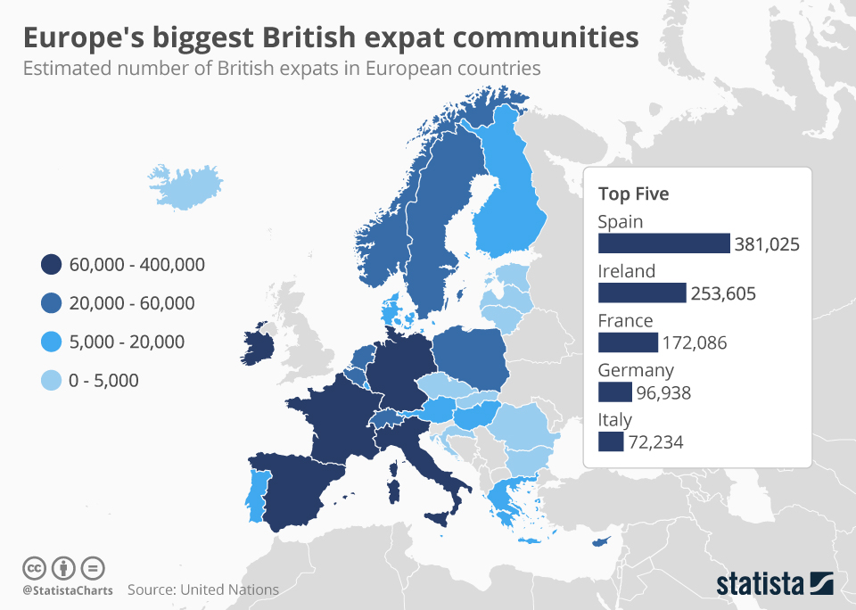
The Mission of the Church
There are three main categories of people who arrive in the UK or other countries who have not originated there. These include:
Migrants: A migrant is a person who moves from one region or country to another for various reasons such as marriage, education, work or safety.
Economic migrants: A person who has moved to another country voluntarily to improve their quality of life through work or study.
Asylum Seekers: An asylum seeker is a person who has made a legal claim to be considered for refugee status and whose claim is still being considered.
Most British people who leave the UK to live in another country are actually retired and do so through choice, unlike many people coming to Europe they have not had to flee for their own safety or to seek employment.

Slide 7
The Mission of the Church
Task B
Approximately what percentage of the world’s population are Christian?
On which continents is Christianity found?
What is the main belief shared by all Christians?
Why did the Catholic population in Scotland grow during the 19th century?
How did the Catholic Church support the new Catholic community in Scotland?
What are the three main categories of people who arrive in the UK to start a new life here?
List some of the reasons why people may leave their homeland.
If you were given the opportunity to live in Scotland all your life or to emigrate to another country of your choice, what would you do, where would you go, and why would you go there?

Slide 8
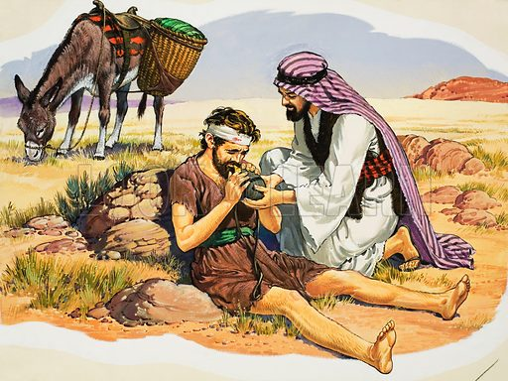
The parable of the Good Samaritan
The Mission of the Church

Slide 9
The Mission of the Church
And now a lawyer stood up and, to test him, asked: “Master, what must I do to inherit eternal life?” He said to him: “What is written in the Law? What is your reading of it?” He replied: “You must love the Lord your God with all your heart, with all your soul, with all your strength, and with all your mind, and your neighbour as yourself.” Jesus said to him: “You have answered right, do this and life is yours.” But the man was anxious to justify himself and said to Jesus: “And who is my neighbour?” In answer Jesus said: “A man was once on his way down from Jerusalem to Jericho and fell into the hands of bandits; they stripped him, beat him and then made off, leaving him half dead. Now a priest happened to be travelling down the same road, but when he saw the man, he passed by on the other side. In the same way a Levite who came to the place saw him and passed by on the other side. But a Samaritan traveller who came on him was moved with compassion when he saw him. He went up to him and bandaged his wounds, pouring oil and wine on them. He then lifted him onto his own mount and took him to an inn and looked after him. Next day, he took out two denarii and handed them to the innkeeper and said: ‘Look after him, and on my way back I will make good any extra expense you have.’ Which of these three, do you think, proved himself a neighbour to the man who fell into the bandits' hands?” He replied: “The one who showed pity towards him.” Jesus said to him: “Go, and do the same yourself.” (Luke 11: 27-37)

Slide 10
The Mission of the Church
Task C
What question did the man ask Jesus?
What answer did Jesus give to the man about how we should act?
In the story where was the man travelling to and from?
What happened to the man?
Who ignored the man at the side of the road, are you surprised by this? Explain
Who helped the man at the side of the road?
Why would the people listening to Jesus be surprised at this?
Are there people where you come from who do not get along even though they don’t really know each other?
Can you think of examples when people judge others when they don’t know them?
What does this story tell us about how we should treat people who are different from ourselves?
Create your own modern-day version of the parable of the Good Samaritan. Remember to include: ‘where, when, who, why, and what’ to help you make the story as realistic as possible.

Slide 11
The story of St Paul
The Mission of the Church
The Conversion of St Paul, was, according to the New Testament, an extremely important event that took place in the life of Paul the Apostle and had an everlasting impact on the Church. His previous name was Saul and he was a man who did not like the early Christians at all. He was born in the city of Tarsus in modern day Turkey. He was a very intelligent and well-educated Jewish man who did not support Christianity. In fact, he set out to kill them and wipe out Christians. However, on the way from Jerusalem to Damascus, where he wanted to persecute the Christian community, he had a life-changing experience. A dazzling light struck Saul and knocked him off his horse, temporarily blinding him. While lying on the ground he heard the voice of God asking him: “Saul why are you persecuting me?” This gave Saul a great many things to think about. It was because he was destroying the Christian community that God spoke directly to him. This led him to end his persecution of the early Christians and to become a follower of Jesus.

Slide 12
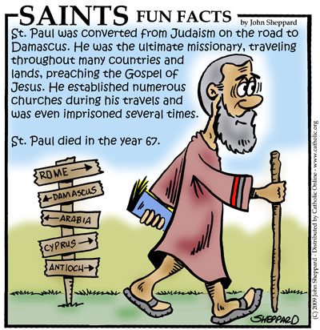
The Mission of the Church
Task D-Step Inside
Imagine that you were in St Paul’s situation on the road to Damascus. Try to answer the following questions:
What can this person see, observe or notice?
What might this person know, understand, hold true or believe?
What might this person care deeply about?
What might this person wonder about or question?

Slide 13
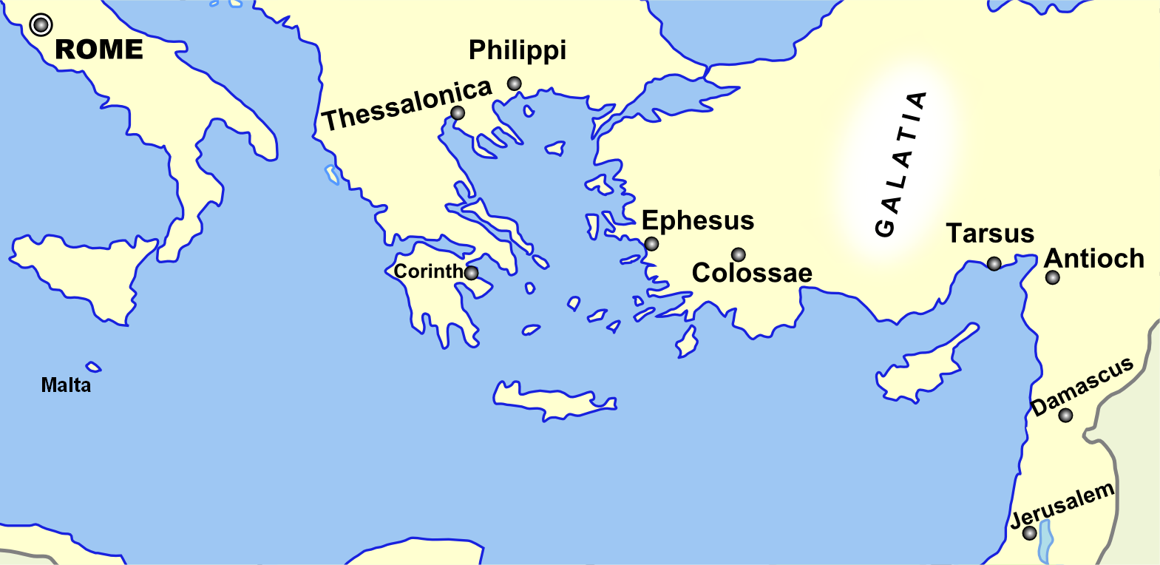
The Mission of the Church
St Paul was one of the great missionaries of the Christian faith. This means that he spread the teachings of Jesus wherever he travelled and he travelled a great many places before his time on earth came to an end! We know the places where he set up Christian churches because he sent letters back to these people. These places were in modern day Turkey, Greece and Italy. The towns were: Colossae; Ephesus; Philippi, Thessalonica; Corinth and Rome. Paul is the patron saint of missionaries. Missionaries are people who dedicate their lives to spreading the good news of Jesus to foreign lands.

Slide 14
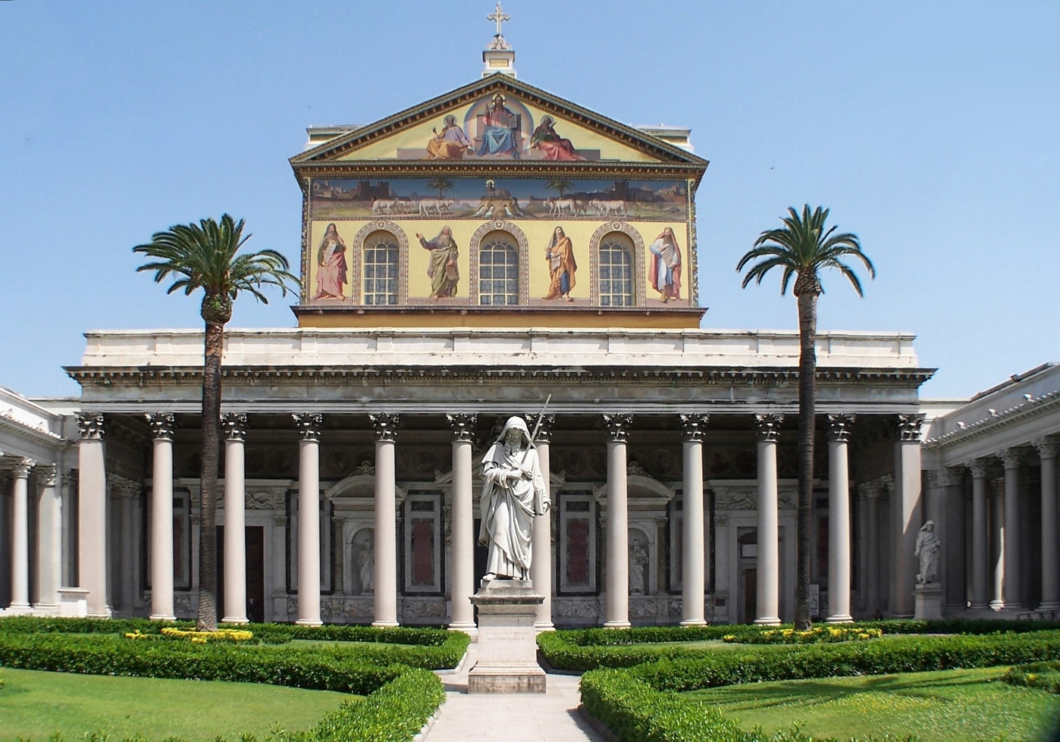
The Mission of the Church
Paul had Roman citizenship so asked that his trial be held in Rome. This was granted and Paul travelled there to explain himself and why he held his Christian beliefs. Being a Christian at that time was illegal and punishable by death. Many Christians were fed to the lions, some crucified or beaten to death, but St Paul’s life ended in another way. He could not be crucified because he was a Roman citizen. Instead, he was taken outside the great walls of the city of Rome and his head was chopped off! There is a Catholic Church built near where St Paul died. It is called San Paolo fuori le Mura, which means in English ‘St Paul outside the walls.’

Slide 15
The Mission of the Church
Paul had a very difficult life and, in his letters, he explains this to the Christian communities. In 2 Corinthians 11:20-32 Paul provided a sampling of some of his adversities as a missionary. He wrote that he:
was in prison frequently.
was flogged severely.
had been exposed to death again and again (five times he received from the Jews the forty lashes minus one, three times was beaten with rods, once he was pelted with stones).
was shipwrecked three times, spending a night and a day in the open sea.
was constantly on the move.
had been in danger from rivers, in danger from bandits, in danger from his fellow Jews, in danger from Gentiles; in danger in the city, in danger in the country, in danger at sea; and in danger from false believers
had laboured and toiled and had often gone without sleep
had known hunger and thirst and had often gone without food
to escape arrest by the governor of Damascus, he was lowered in a basket from a window in the wall and got away.

Slide 16
The Mission of the Church
Task E
What was St Paul’s name before it was changed and where was he born?
What did he do to the early Christian community?
Where was he going and what happened that made Saul change his ways?
St Paul became a great missionary of the Church, where did he travel to and how do we know this?
Paul was sent to face trial in Rome, why was this?
How was St Paul killed?
What stands near to where St Paul was killed?
What were some of the difficulties that St Paul faced in his life?
Was St Paul a good Christian? Explain
In what ways was St Paul similar to some asylum seekers today?
Use the online mapmaker to create either St Paul’s journeys across the Roman Empire or you can create a modern-day person’s journey from a country of your choice to the UK.

Slide 17
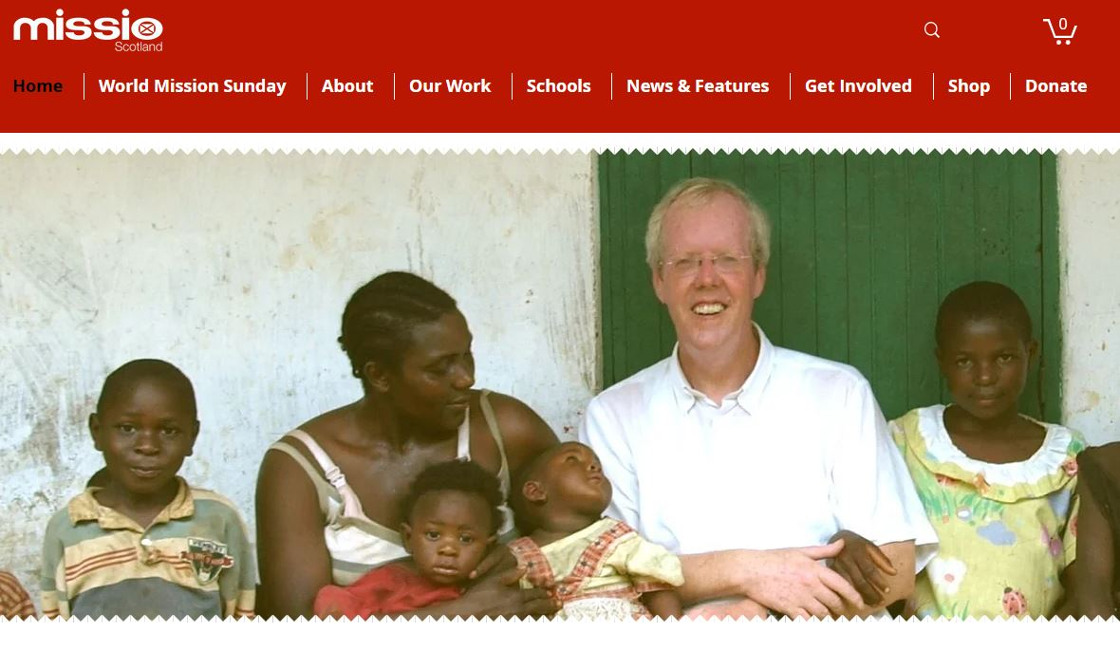
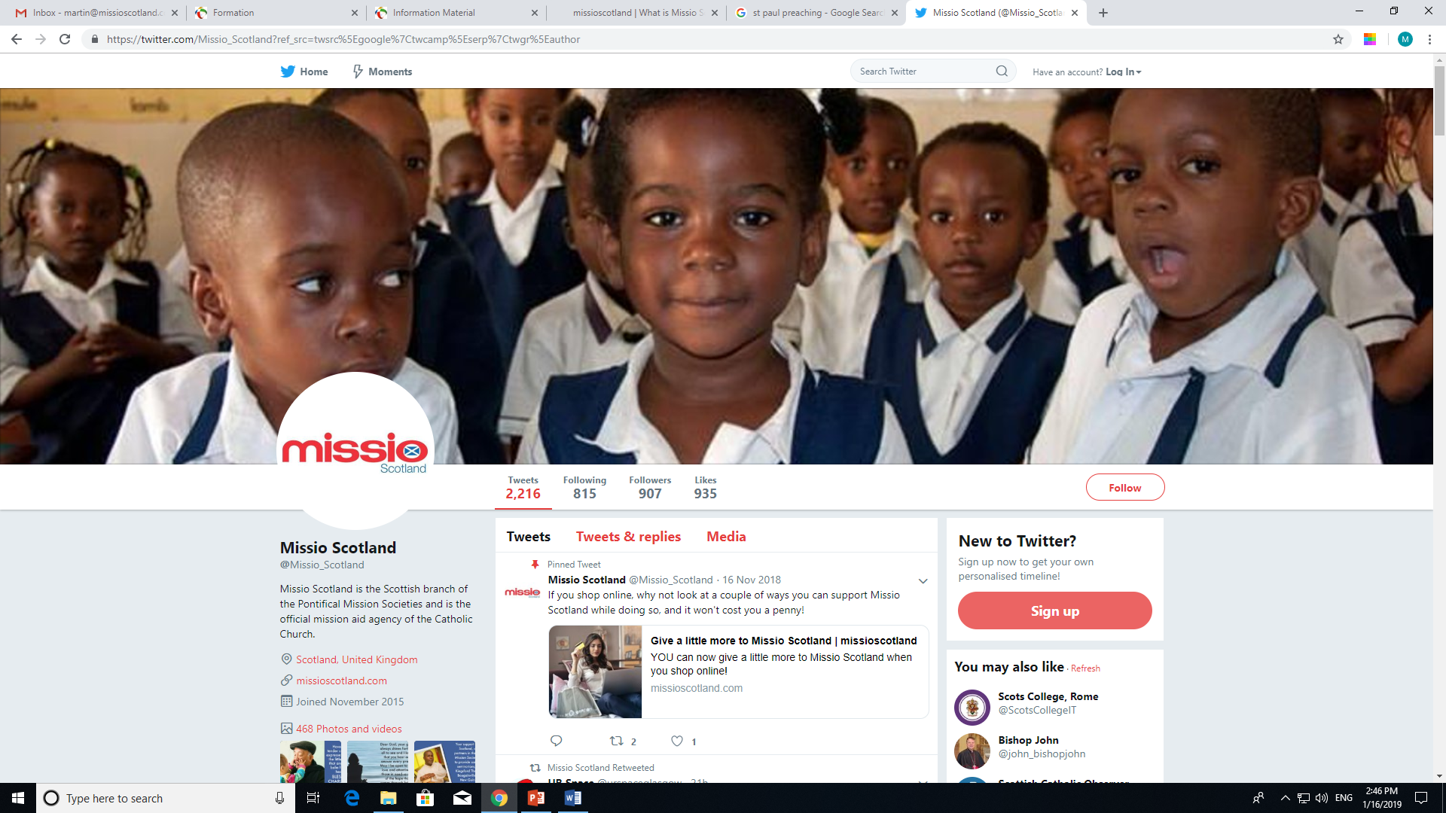
What is Missio Scotland?
The Mission of the Church
Missio Scotland is the Scottish branch of the Pontifical Mission Societies and is the official mission aid agency of the Catholic Church, continuing the mission of Jesus Christ in the world. Missio reaches out, gives life and calls all people in the world to faith, justice and love.
Since 1922, Missio has been the Catholic Church's official charity for overseas mission. We bring the hope of the Gospel where there is turmoil, poverty and uncertainty in the world, and where the Church is new, young or poor.
Grassroots needs are identified by local Catholics, to give people the opportunity for a full, enriched life—physically and spiritually—regardless of race, stigma, religion or gender.

Slide 18
The Mission of the Church
Missio, through the Pontifical Mission Societies, operates in over 160 countries to support initiatives in 1100 dioceses on five continents.
​To provide for the different needs of the overseas Church, Missio focuses on four main areas of provision:
​Caring for our Church family and sending missionaries overseas
Training future priests and sisters overseas (in their own country)
Supporting children's faith and development projects
Nurturing a worldwide missionary spirit.
Those who dedicate their lives to the missionary work of the Church by spreading the Word of God worldwide do this in a variety of ways. They may physically travel to other parts of the world teaching in schools, managing care homes or providing medical assistance to those in need. However, the vast majority of people may never get the chance to travel on missionary journeys, but they continue to support Missio through prayer and fundraising. This is in keeping with the message that Jesus left us (John 13:1-17):

Slide 19
The Mission of the Church
Jesus… got up from table, removed His outer garments and, taking a towel, wrapped it round His waist; He then poured water into a basin and began to wash the disciples' feet and to wipe them with the towel He was wearing.
He came to Simon Peter, who said to Him: “Lord, are you going to wash my feet?” Jesus answered: “At the moment you do not know what I am doing, but later you will understand.” “Never!” Simon Peter said. “You shall never wash my feet.” Jesus replied: “If I do not wash you, you can have no share with me.” Simon Peter said: “Well then, Lord, not only my feet, but my hands and my head as well!”
Jesus said: “No one who has had a bath needs washing, such a person is clean all over. You too are clean, though not all of you are.” He knew who was going to betray Him, and that was why He said, 'though not all of you are.’
When He had washed their feet and put on His outer garments again, He went back to the table. “Do you understand,” He said, “what I have done to you? You call me Master and Lord, and rightly so, I am. If I, then, the Lord and Master, have washed your feet, you must wash each other's feet. I have given you an example so that you may copy what I have done to you. In all truth I tell you, no servant is greater than his master, no messenger is greater than the one who sent him. Now that you know this, blessed are you if you behave accordingly.”

Slide 20
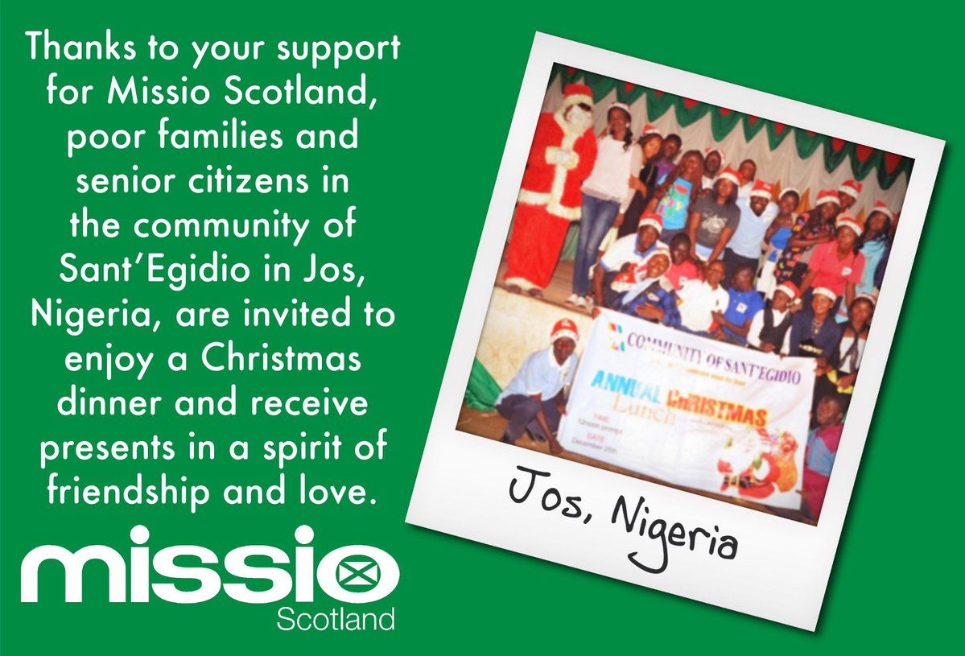
The Mission of the Church
World Mission Sunday
World Mission Sunday falls on the penultimate Sunday in October and is the climax of Mission Month, a time in which we ask schools and parishes to focus more fully on the work of missions and missionaries worldwide. World Mission Sunday is the one Sunday in the year when the Mass is celebrated exclusively for missionary activity. Donations are collected at these worldwide Masses and they go to support churches, hospitals, schools and vocations in countries where the Church is new, young or poor.

Slide 21
The Mission of the Church
Task F
When was Missio Scotland founded?
How many countries does Missio currently work in?
What are the four main areas of Missio Scotland’s work?
What form of service did Jesus provide for the apostles?
What did Simon-Peter say to Jesus?
Why do you think that Simon-Peter tried to stop Jesus, was he doing what he thought to be right and do you agree with Simon-Peter?
How do missionary priests follow the example Jesus set by serving the apostles?
Think back to the first task, historically would Scotland have needed the help of an organisation like Missio? Why would this have been the case?
What month is dedicated by the Catholic Church to the work of missionaries?
If you could be given the opportunity to work with Missio Scotland and travel on a missionary journey would you take that chance? Explain your answer.
How can we as Christians help Missio Scotland?

