Slide 1
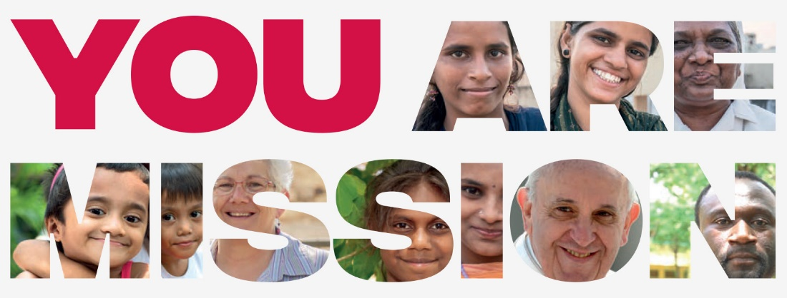
The Church at Work in our World
Peace… is an order that is founded in truth, nurtured and animated by charity, and brought into effect under the auspices of freedom.
Pacem in Terris, 1963, #167

Slide 2
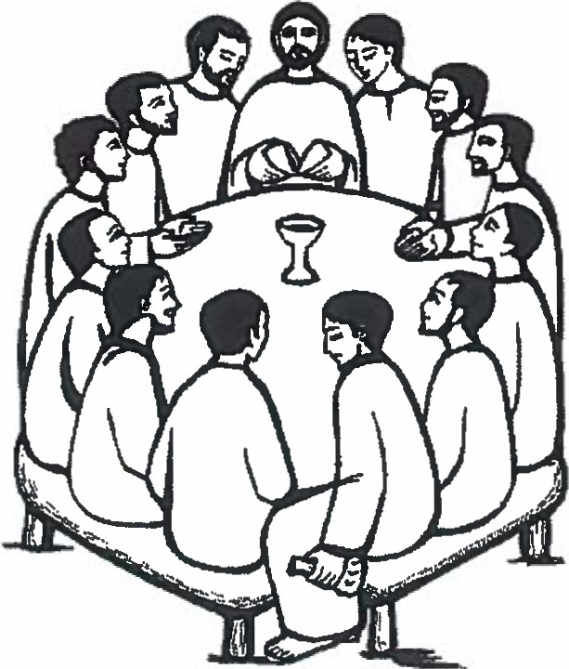
The Church at Work in our World
The Eucharist
A Sacrament in the Catholic Church is a rite that Catholics believe was established by Jesus Christ. The Seven Sacraments of the Catholic Church are its most sacred and ancient rites of worship. Receiving a Sacrament brings grace (God’s love) to everyone who participates in the ritual.
The most sacred of all the Seven Sacraments is the Holy Eucharist.

Slide 3
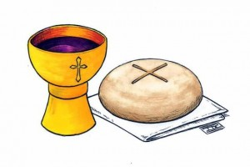
The Church at Work in our World
Catholics believe that Jesus is present in the Eucharist (both the bread and the wine). This is called transubstantiation. The celebration of the Eucharist, or sometimes called Holy Communion, can be traced back to Jesus Himself on the evening before He was put to death. After washing His disciples’ feet, Jesus shared a final meal with them. This is called The Last Supper.
Jesus broke bread and blessed it and told His disciples: “Take this all of you and eat it. This is my body broken for you. Do this in memory of me.”
Jesus took some wine and said: “Take this and drink it. This is my blood poured out for you.

Slide 4
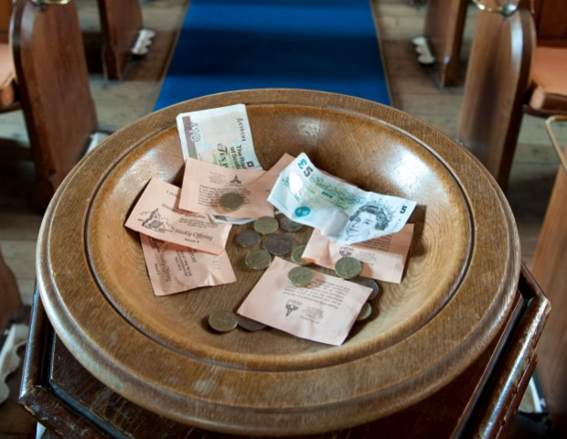
The Church at Work in our World
From the very beginning, Christians have brought, along with the bread and wine for the Eucharist, gifts to share with those in need. This custom of the collection is inspired by the example of Christ who became poor to make us rich.
As we know, it is also customary nowadays to take up a financial collection at this time. Sometimes special collections are taken up to help those in particular need e.g. food parcels that are given to the needy by the parish.

Slide 5
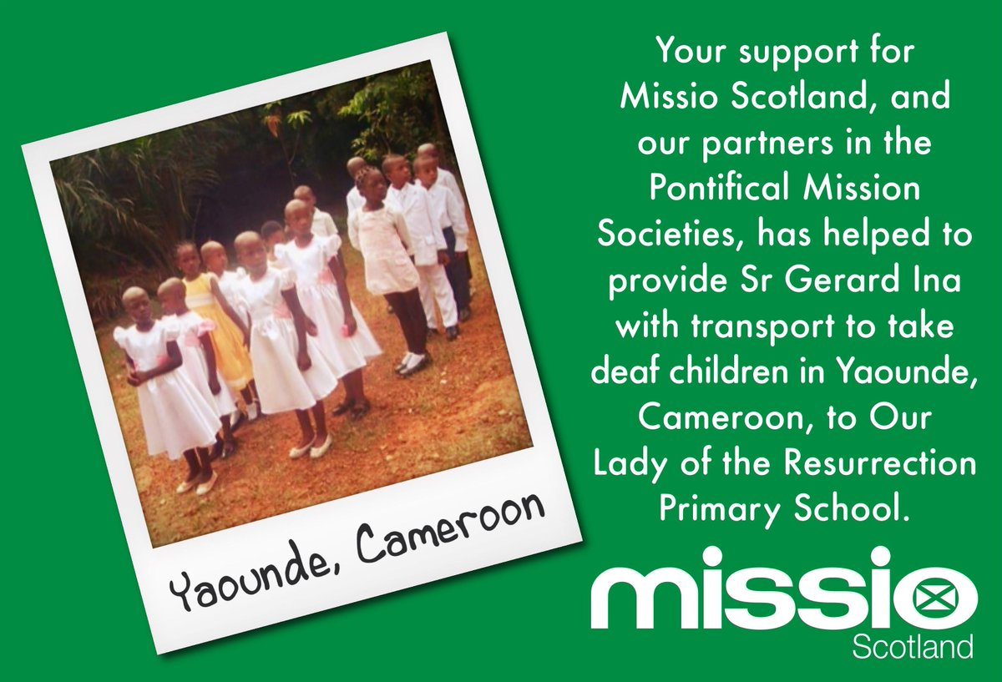
The Church at Work in our World
It is the celebration of the Eucharist that nourishes our souls and unites Catholics all over the world bringing us closer to God.
The desire to help others by putting faith into action by doing good or giving to those less fortunate is an essential aspect of the Catholic Faith.

Slide 6
The Church at Work in our World
Task A
How many Sacraments are there in the Roman Catholic Church?
What is a Sacrament a sign of?
What name is used to explain the Catholic belief that Jesus is fully present in the bread and wine?
When did the first ever Mass take place and what words are spoken by the priest every time Mass is celebrated?
Who did Christians traditionally bring gifts for during the offertory at Mass?
What do most people give during Mass instead of bringing material things with them to donate?
Imagine you are organising the Presentation of the Gifts in a Eucharistic celebration for the following groups of people. Apart from the bread and wine, which other ‘gifts’ might symbolically represent their own situation and reflect what they are offering of themselves? Choose TWO different groups from the following list and EXPLAIN which things might be offered and what their significance would be: 1) A Primary 7 class 2) A group of construction workers 3) A group of refugees 4) A group of farmers 5) A group of scientists 6) A sports team

Slide 7
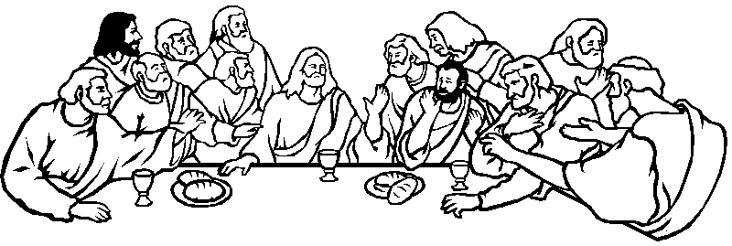
The Church at Work in our World
The famous painting of the Last Supper by Leonardo Da Vinci is one of the most famous pieces of artwork in the world. Create your own last supper with any person, famous or ordinary citizen, alive or passed away, to a meal of your choosing.

Slide 8
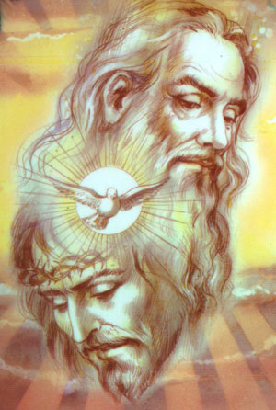
The Church at Work in our World
The Holy Spirit and Faith Witness
In the Gospels, Jesus reveals God as Father, Son and Holy Spirit. This is known as the ‘Mystery of the Blessed Trinity.’ In the Blessed Trinity we begin to understand the true nature of God.
There is only one God, but three persons. The trinity is one. There are not three Gods, but three persons in one God. These three persons are one and yet they are distinct, Father, Son and Holy Spirit.

Slide 9
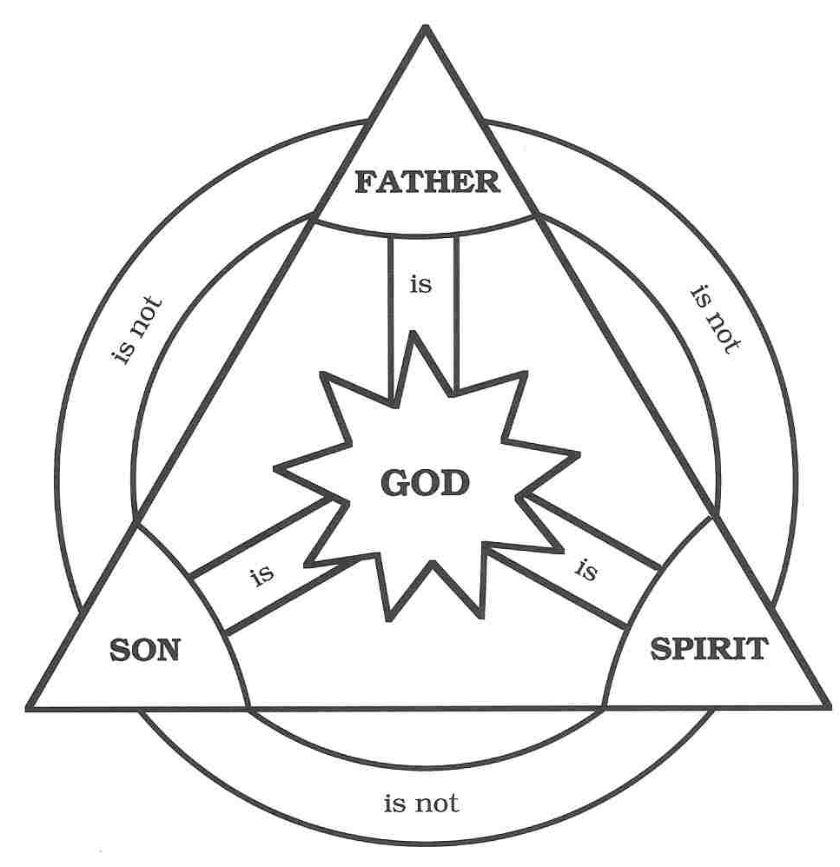
The Church at Work in our World
God the Father of Creation: The transcendent nature of God who is beyond us, who created the world and keeps it going. This is the understanding of God who loves us and who is greater than we can ever imagine.
God the Obedient Son: The immanent and personal nature of God. This is God beside us, who came to earth and lived a human life and showed His love on the cross.

Slide 10
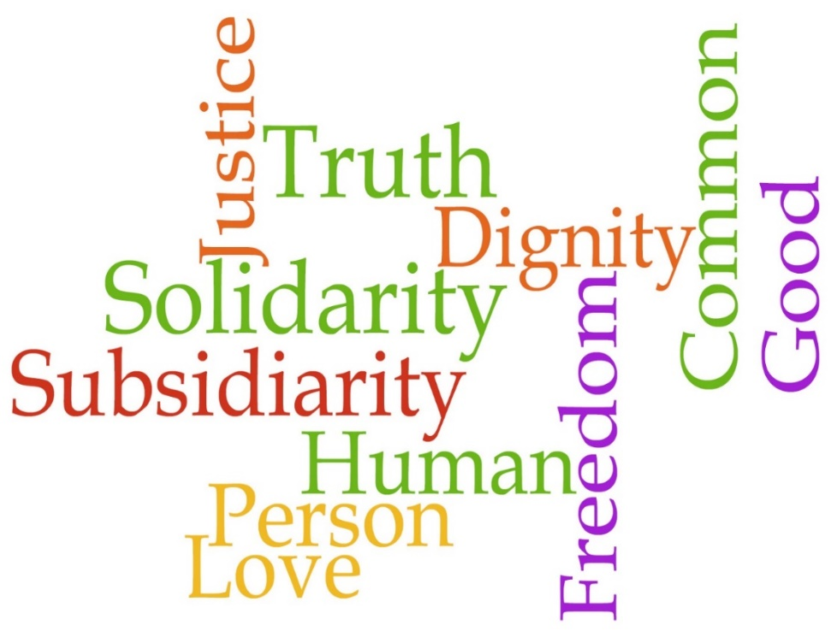
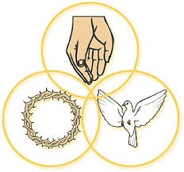
The Church at Work in our World
God the Spirit of Love: The immanent and impersonal nature of God. This is God around us who inspires and guides us from day to day. This is the source of love and grace of God working in us.
The mission of the Catholic Church is to promote the Gospel and guide people in leading lives that are good. It is the Holy Spirit that continues to guide the Church and guide people in their lives giving us the freedom to act.

Slide 11
The Church at Work in our World
Pope Francis explained: “There are still many Christians today who are unaware of how the Holy Spirit moves the Church. He's the one who works in the Church, in our hearts, He is the one who makes each Christian unique, but united together as one family of God. It's the Holy Spirit who opens the doors and invites us to bear witness to Jesus, as well as inspiring people to pray and to see God as father, liberating individuals.”
All Christians are called to show love of God and love of neighbour and to put their faith into action by striving to make the world a better place for all—this is called Catholic Social Teaching.

Slide 12
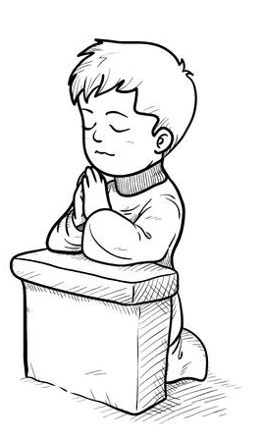
The Church at Work in our World
Task B
What do Christians believe is revealed about the nature of God in the Gospels?
What are the three distinct persons of the Trinity?
What is the mission of the Catholic Church?
What person of the Trinity continues to guide the Church?
Do you agree that all people can act in ways that make the world a better place? Explain your answer.
“Prayer is the place of refuge for every worry, a foundation for cheerfulness, a source of constant happiness, a protection against sadness.” St John Chrysostom
Do you agree that prayer brings benefits to people’s lives?
Create a poster explaining the Trinity

Slide 13
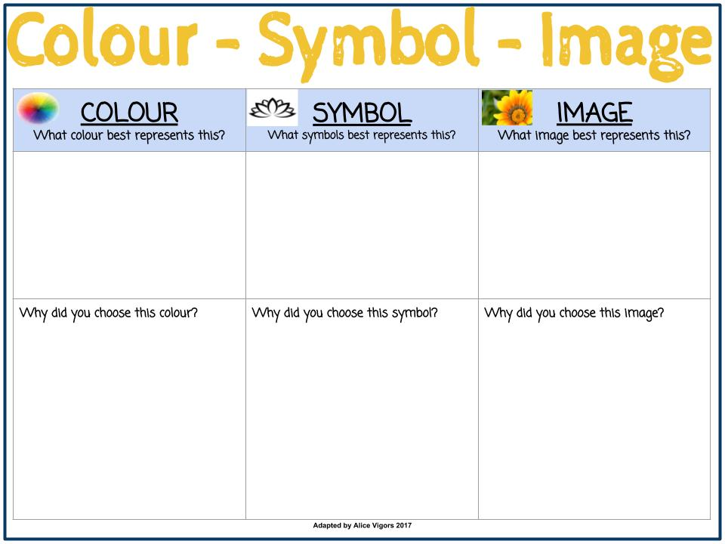
The Church at Work in our World
Task
Create a colour-symbol-image that you think represents the Holy Trinity

Slide 14
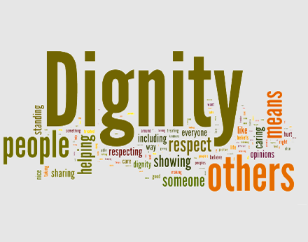
The Church at Work in our World
Wisdom and Compassion
Human dignity is something that can’t be taken away. Catholic Social Teaching states that each and every person has value, are worthy of great respect and must be free from slavery, manipulation and exploitation. Catholic belief is that all human beings are created in the image and likeness of God and therefore are worthy of respect and dignity.

Slide 15
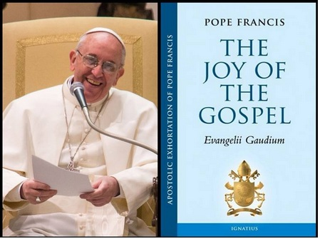
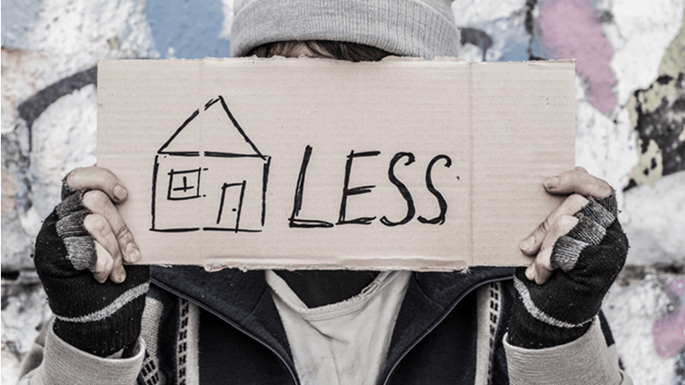
The Church at Work in our World
“How can it be that it is not a news item when an elderly homeless person dies of exposure to the cold, but it is news when the stock market loses two points? This is a case of exclusion.”
Pope Francis, Evangelii Gaudium

Slide 16
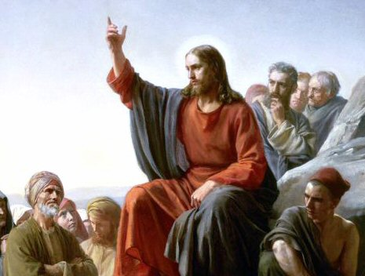
The Church at Work in our World
All Catholics are called to put their faith into action by making the world a better place. Jesus upset the ancient world view on how to treat people and advocated a new commandment to love.
“You have heard how it was said: ‘Eye for eye and tooth for tooth.’ But I say this to you: offer no resistance to the wicked. On the contrary, if anyone hits you on the right cheek, offer him the other as well... And if anyone requires you to go one mile, go two miles with him. Give to anyone who asks you, and if anyone wants to borrow, do not turn away. 'You have heard how it was said, You will love your neighbour and hate your enemy. But I say this to you, love your enemies and pray for those who persecute you; so that you may be children of your Father in Heaven... For if you love those who love you, what reward will you get? …And if you save your greetings for your brothers, are you doing anything exceptional?” (Matthew 5:38-46)

Slide 17
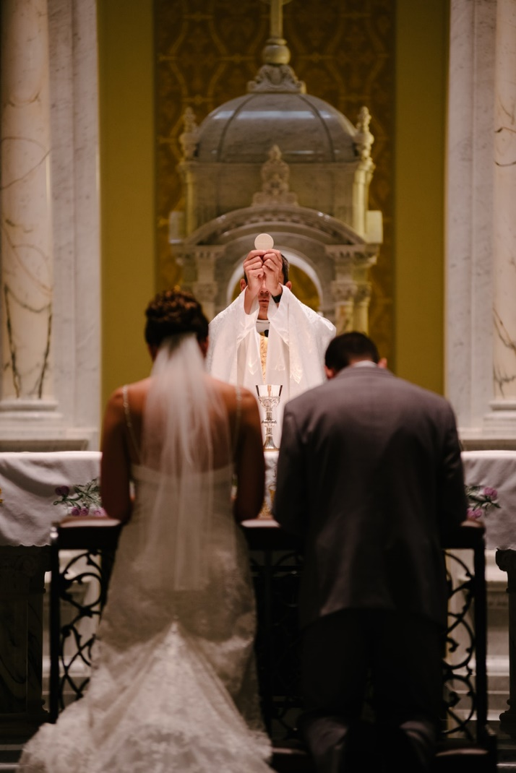
The Church at Work in our World
St Paul in his letter to the people of Corinth elaborates on Jesus’ commandment of love. This scripture passage is often used during the mass at weddings. When someone truly loves another person they are willing to put that person before themselves.
“Love is always patient and kind; love is never jealous; love is not boastful or conceited, it is never rude and never seeks its own advantage, it does not take offence or store up grievances. Love does not rejoice at wrongdoing, but finds its joy in the truth. It is always ready to make allowances, to trust, to hope and to endure whatever comes.” (1 Corinthians 13:4-7).

Slide 18
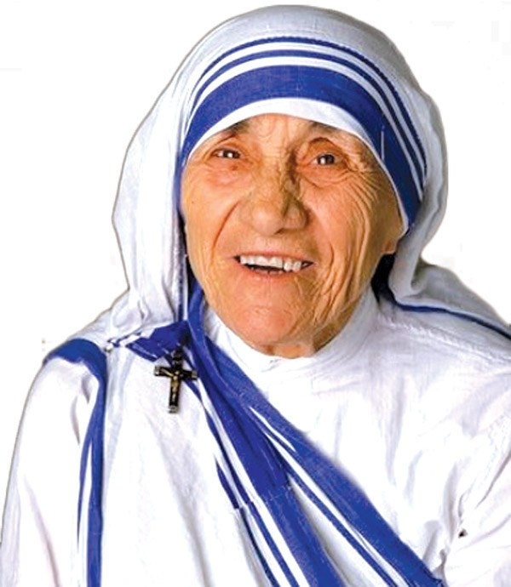
The Church at Work in our World
"Spread love everywhere you go: first of all in your own house. Give love to your children, to your wife or husband, to a next-door neighbour... Let no one ever come to you without leaving better and happier. Be the living expression of God's kindness; kindness in your face, kindness in your eyes, kindness in your smile, kindness in your warm greeting." St Mother Teresa of Calcutta

Slide 19
The Church at Work in our World
Task C
Imagine that you could guarantee every human being in the world five things. What five things would you guarantee them and why? For example, a safe place to live…
Do you agree that every single person deserves to be treated with respect? Explain
Why do you think that governments often seem to worry more about money than about the people living within their own country?
Do you think that it is possible for a person to resist the temptation for revenge if someone has wronged them? Explain
Do you think it is acceptable to take revenge on someone if they have done you wrong?
When we truly love someone, we put their needs before our own. In what ways do people who love you put your needs before their own?
How do you put the needs of those whom you love before yourself?
Read the Mother Theresa quote. What problems come to mind when you read it? What questions come to your mind about the quote?

Slide 20
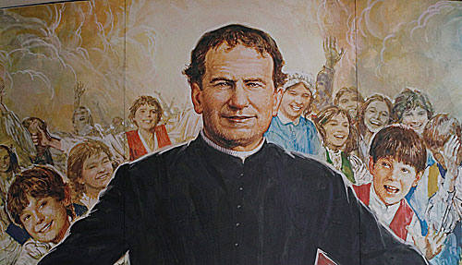
The Church at Work in our World
Saint John Bosco (August 16, 1815-January 31 1888), popularly known as Don Bosco, was an Italian Roman Catholic priest, educator and writer of the 19th century. While working in Northern Italy he dedicated his life to supporting and educating street children, juvenile delinquents, and other disadvantaged youths. He developed teaching methods based on love rather than punishment, a method that became known as the Salesian Preventive System. This was a very unusual form of teaching and one that the Salesian Order still uses today.

Slide 21
The Church at Work in our World
A Wisdom Figure in Don Bosco’s Early Life
John Bosco was lucky to find a wise guide as he was growing up. He was a local parish priest called Fr Calosso. John met him while running back to his home from Mass. The priest shouted a friendly hello and John stopped. Priests didn’t usually talk to young people, but Fr Calosso seemed different. Hearing that John had been to Mass, Fr Calosso asked John what the sermon was about. To the priest’s amazement John repeated the whole sermon word for word. “Who are you?” Fr Calosso asked. Hearing that he was Margaret’s boy, he dropped in to see the family and soon arranged for John to go to him for lessons so that his obvious talent could be developed. John was delighted and he very quickly learnt a lot about writing, history, Latin and scripture. Things seemed to be looking up for John at last. But then Fr Calosso became terminally ill and he could not give any more lessons.

Slide 22
The Church at Work in our World
However, he did tell John in public that when he died, he wanted John to have all his money to help with his studies. He gave him a key and pointed to a cupboard saying that the money in there was for him. All too soon Fr Calosso died and his relatives came to mourn. There was a lot of talk about Fr Calosso’s money, and John was so upset about losing his friend and guide that he could not stand the money arguments. After a few hours, he gave the key to Fr Calosso’s nephew saying that he did not want to be the cause of any family arguments at such a sad time.
Key Point: We all need wise people in our lives. People we can trust and who can teach us in a friendly and safe way about life. Some people come into and out of our lives very quickly and leave us changed. Who has been your wise guide? Who has left you changed?

Slide 23
The Church at Work in our World
Task
Read the story of St John Bosco & Secondo again.
Complete the word-sentence-phrase Making Thinking Visible task.

Slide 24
The Church at Work in our World
Task D
Read the story A Wisdom Figure in Don Bosco’s Early Life again on your own. Select a word, a sentence and a phrase that stands out to you, that you consider to be an important part of the story.
Put yourself in John Bosco’s place just after his friend Fr Calosso had died and try to answer the following: What can John Bosco see, observe or notice? What might young John know, understand, hold true or believe? What might John Bosco care deeply about? What might John wonder about or question?
Could you have given away the money if you knew it was probably your only way to gain an education?

Slide 25
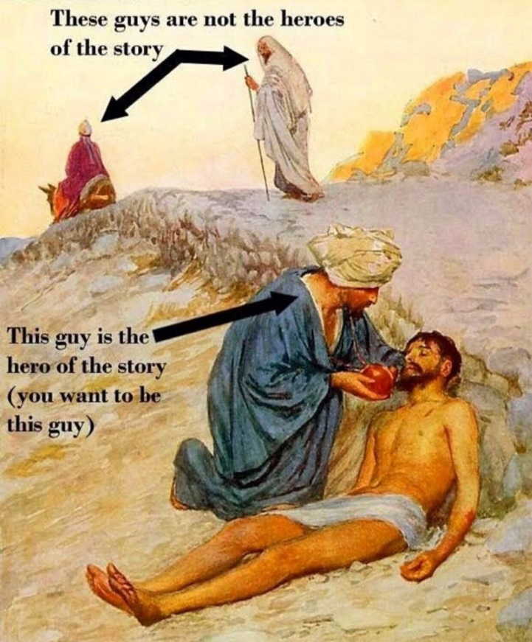
The Call to Holiness and the Four Last Things
The Church at Work in our World
There will be many situations in our own lives where wisdom and compassion contribute to the bringing about of peaceful resolutions to conflict. This can take place within our families, at school, in and around the local community, at a higher level. Sometimes it is very difficult to be the peacemaker in such situations.
The universal call to holiness has always been a teaching of the Church and is rooted in its mission to take people who have fallen short at times and raise them to living lives that can make them worthy of being called saints. In other words, the Church teaches that all Christians must try to be true followers of the example of Jesus—this means being the very best they can be, at all times. Some of us are better at this than others.

Slide 26
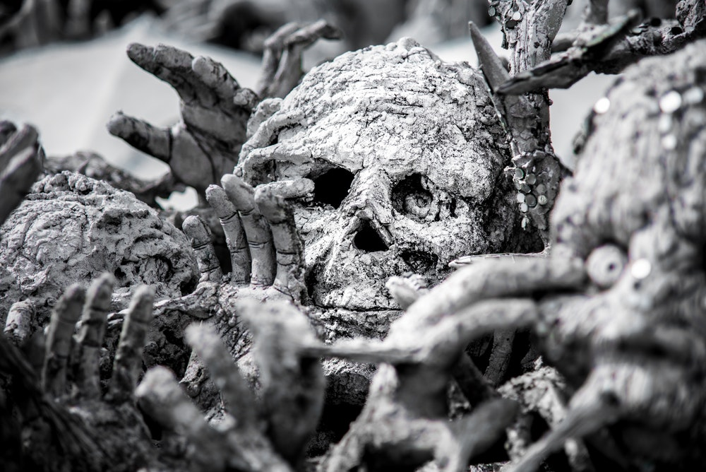
The Church at Work in our World
The Catholic Church teaches that at the end of life we are faced with what are called the Four Last Things which are: Death, judgement, Heaven and Hell. Matthew in his Gospel explains how all who follow Christ are called to follow His example in preparation for the afterlife, the place we often refer to as Heaven.

Slide 27
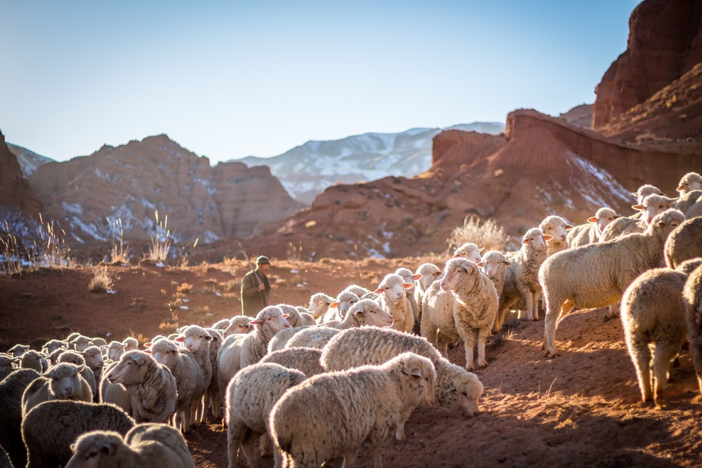
The Church at Work in our World
(Matthew 25: 31- 46)
“When the Son of man comes in His glory, escorted by all the angels, then He will take His seat on His throne of glory. All nations will be assembled before Him and He will separate people one from another as the shepherd separates sheep from goats. He will place the sheep on His right hand and the goats on His left. Then the King will say to those on His right hand: ‘Come, you whom my Father has blessed, take as your heritage the kingdom prepared for you since the foundation of the world. For I was hungry and you gave me food, I was thirsty and you gave me drink, I was a stranger and you made me welcome, lacking clothes and you clothed me, sick and you visited me, in prison and you came to see me.’"

Slide 28
The Church at Work in our World
Task E
What two things contribute to bringing about peaceful resolutions to conflict?
Can you think of situations, either in your own life or at a national/international level, where these things have helped bring about peace?
Copy and complete the following sentence: The Catholic Church explains that through the universal call to holiness we must all try to follow the example of ____________.
What are the Four Last Things?
God is compared to a shepherd separating what animals from each other?
Copy and complete the following paragraph: Then the King will say to those on His _________ hand, ‘Come, you whom my Father has blessed, take as your heritage the kingdom prepared for you since the foundation of the world. For I was _________ and you gave me food, I was thirsty and you gave me _________, I was a _____________ and you made me welcome, lacking clothes and you ____________ me, sick and you visited me, in _________ and you came to see me.’"
Do you believe in Heaven and Hell?
What sort of things could a person do that you think would result in them separating themselves from God forever?

Slide 29
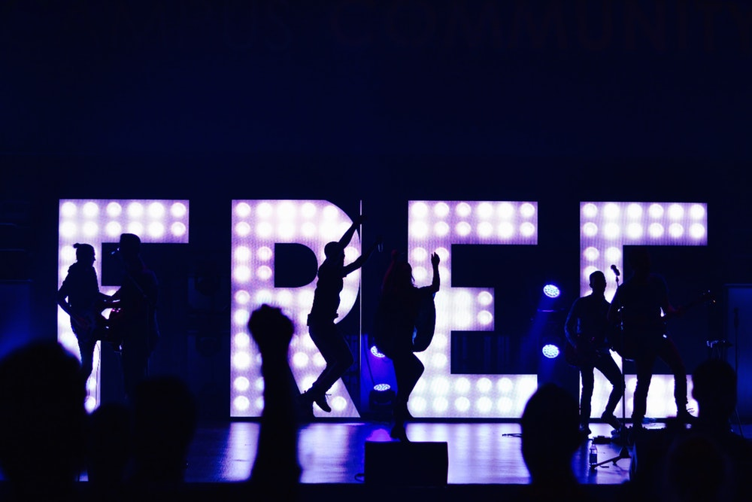
The Catechism of the Catholic Church
The Church at Work in our World
The Catechism is a book that contains the essential beliefs and teachings of the Catholic faith. The following quote refers to how all human beings should act: “By his reason, man recognises the voice of God which urges him ‘to do what is good and avoid what is evil.’ Everyone is obliged to follow this law, which makes itself heard in conscience and is fulfilled in the love of God and of neighbour. Living a moral life bears witness to the dignity of the person.” (1706)

Slide 30
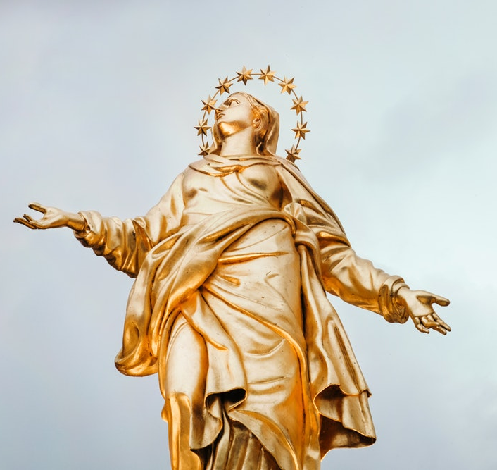
The Church at Work in our World
All Christians believe that God created our world and all that is in it. Human beings are the highest expression of God’s creation because they are made in God’s image and likeness. Humans are like God because we have a soul. The soul has two very important gifts which are:
Intellect
Will (sometimes called free will)

Slide 31
The Church at Work in our World
Intellect allows us to come to understand whether something is good or bad, right or wrong. Will allows us to decide whether to perform an action that we know to be right or wrong, good or bad. Christians believe that we can choose right or wrong because we are created in the image and likeness of God. This belief in God can and does have a lasting effect on the lives of billions of people across the world today not to mention people from the past!
So, it is our duty not only as Christians but as human beings to do good rather than evil.

Slide 32
The Church at Work in our World
One of the ways that the Catholic Church puts this belief into practice throughout the world is through charitable works. The Pontifical Mission Societies (Missio Scotland) has been the Catholic Church's official charity for overseas mission since 1922.
Missio brings the hope of the Gospel where there is turmoil, poverty and uncertainty in the world, and where the Church is new, young or poor. Areas of need are identified by local Catholics, to give people the opportunity for a full, enriched life—physically and spiritually—regardless of race, stigma, religion or gender.

Slide 33
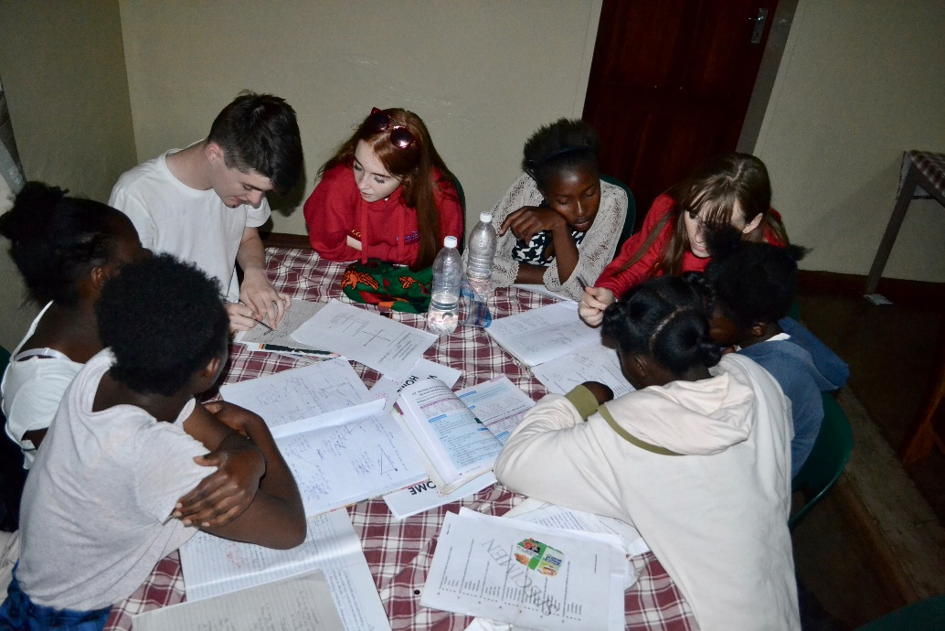
The Church at Work in our World
The Church then supports people in these areas in a variety of ways. Missio—through the Pontifical Mission Societies—operates in over 160 countries to support initiatives in 1100 dioceses on five continents.
To provide for the different needs of the overseas Church, Missio focuses on four main areas of provision:
Caring for our Church family and sending missionaries
Training future priests and sisters overseas
Supporting children's faith and development projects
Nurturing a worldwide missionary spirit

Slide 34
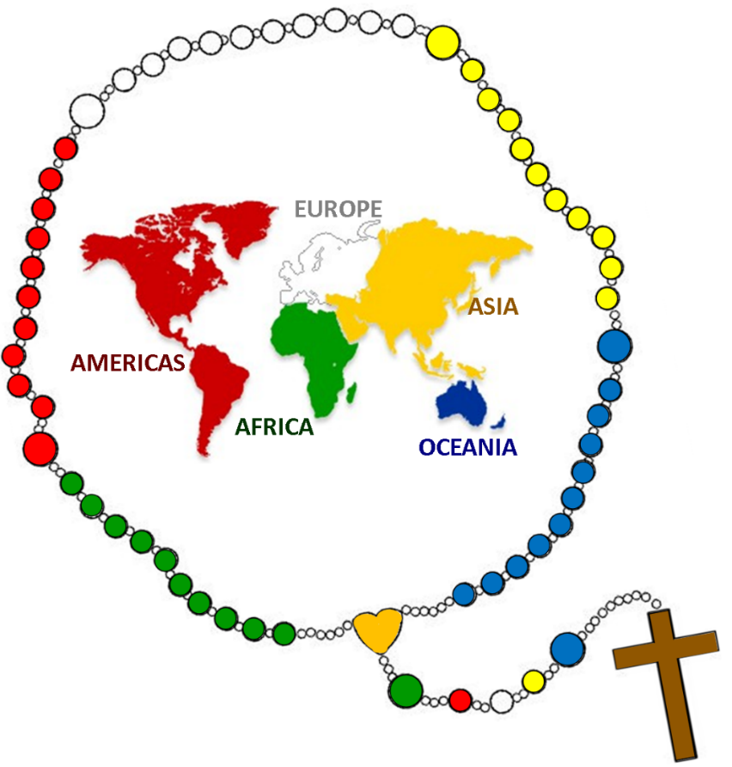
The Church at Work in our World
During the month of October, the Catholic Church holds a special collection in every congregation throughout the world for the Missionary Church. This means that money is sent to support the Church where it is poor or young, for example countries in Africa or Asia.
Missio works on five continents providing education for pupils, education for those studying for the religious life, medical facilities and training for self-sustaining projects such as agriculture. Other ways that Missio Scotland is funded is through collections undertaken by pupils in Catholic primary schools and the fundraising efforts of volunteers. Since 2009, Missio Scotland has sent approximately £3,747,030:43 to the missions.

Slide 35
The Church at Work in our World
Task F
According to the Catechism of the Catholic Church what are all Catholics called to avoid?
What does the Catholic Church teach that all humans have?
What are the gifts of the soul?
What is Missio Scotland’s official name?
When did Missio Scotland become the official charity for overseas missions?
What four areas of provision does Missio Scotland concentrate on providing?
How many countries does Missio work in?
Name two ways that Missio Scotland receives money to fund missionary projects
If you could be given the opportunity to work overseas on missionary projects, where would you like to go and what would you like to do?

