Slide 1
Little Way Week
A Missionary Children initiative

Slide 2
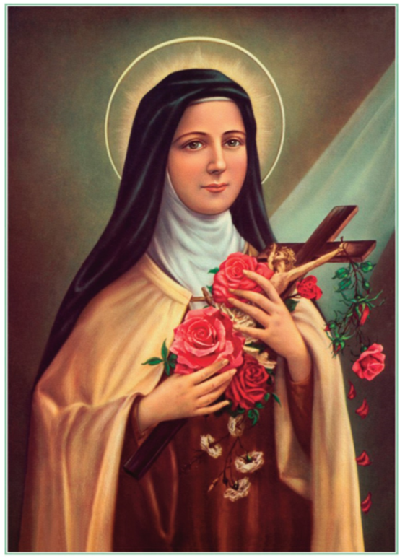
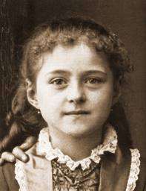
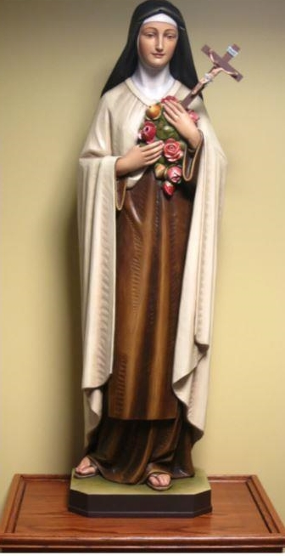
Little Thérèse Martin became one of the world’s most-loved saints.

Slide 3
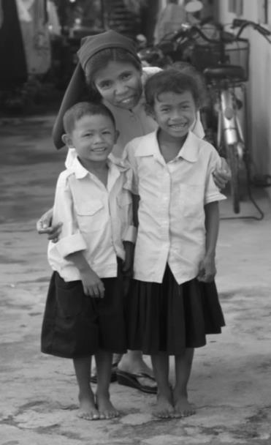
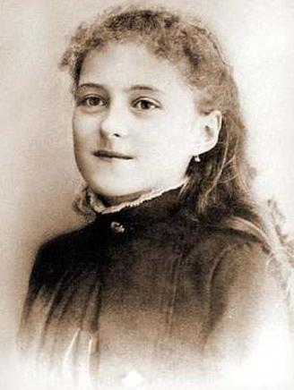
Thérèse wanted to become a missionary nun.

Slide 4
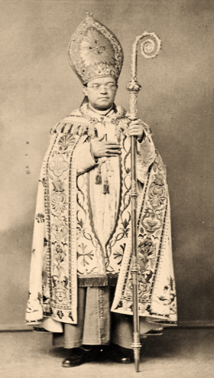
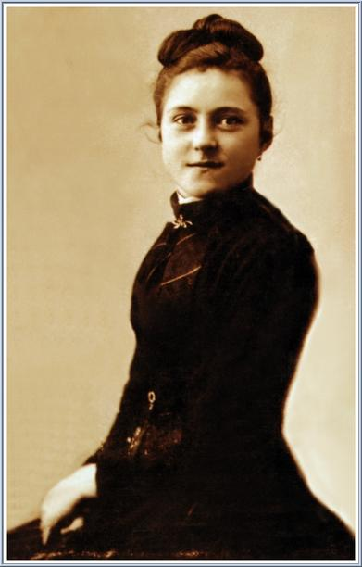
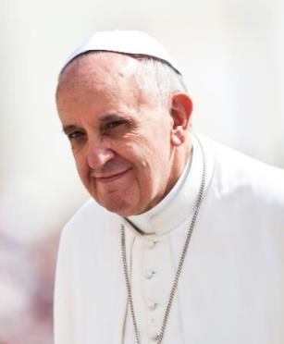
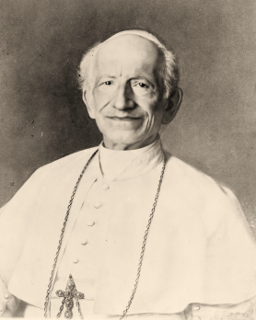
Thérèse asked the Bishop if she could be a nun!

Slide 5
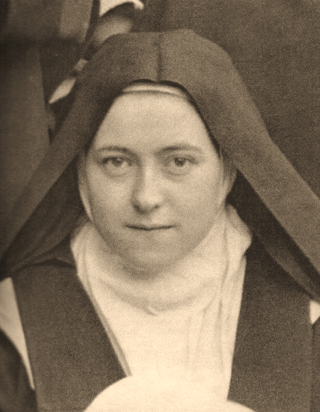
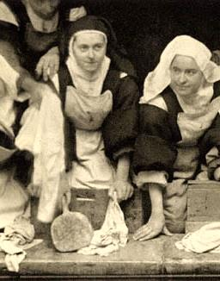
Little Way Week
“Little acts of kindness with great love.”

Slide 6
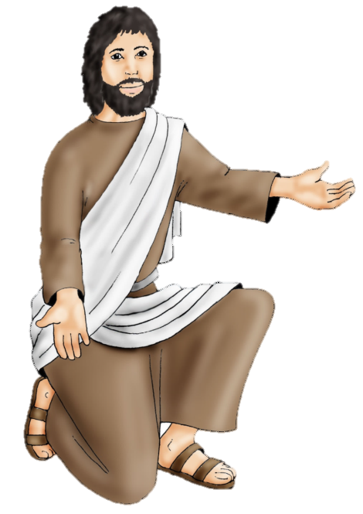
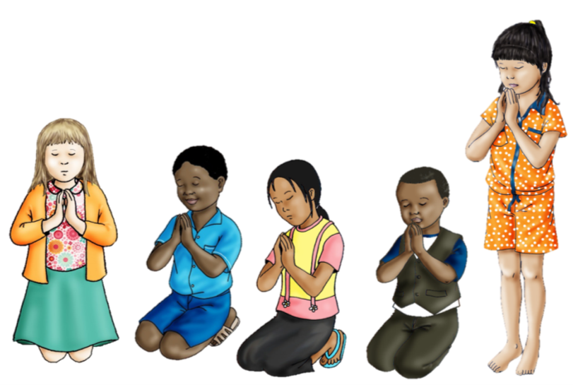
Little Way Week
Jesus told the people: “Love God in every way you can.” This is the first and most important instruction. The second instruction is like the first: “Love all the people around you as you would like to be loved.” Matthew 22:37-39

Slide 7
Little Way Week
Mission Together Prayer:
May all children
In the world
Share love
Share friendship and live
In the peace
Of God’s love.
Now and forever.
Amen

Slide 8
Little Way Week
LITTLE WAY WEEK is an initiative that was produced in partnership by our brothers and sisters at Missio England and Wales, the Catholic Bishops’ Conference of England and Wales and Wednesday Word.

