Slide 1
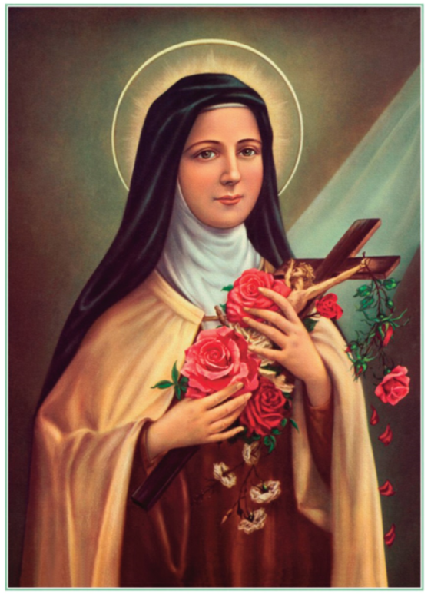
St Therese of Lisieux
The Little Flower of Jesus

Slide 2
St Thérèse of Lisieux
This Is Our Faith
S1 RERC 3- 10a I have explored the belief that the Holy Spirit inspires and empowers the Church to fulfil its prophetic and missionary role in our world today. I have researched into situations which bear witness to this. I can describe how I and others can contribute to this work.
I have considered how the Church, through parishes, dioceses & organisations, helps to support and nurture communities, both in their faith journeys and in their everyday lives.

Slide 3
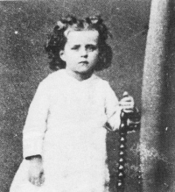
St Thérèse of Lisieux
Early Life
She was born in Rue Saint-Blaise, Alençon, in France on 2 January 1873, the daughter of Marie-Azélie Guérin, and Louis Martin, a jeweller and watchmaker.
Therese Martin was the last of nine children born to Louis and Zelie Martin on January 2, 1873, in Alencon, France. However, only five of these children lived to reach adulthood.

Slide 4
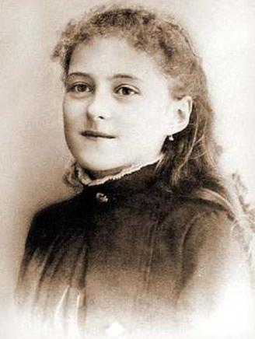
St Thérèse of Lisieux
All five of the Martin daughters became nuns.
—Marie (February 22, 1860, d. January 19, 1940),
—Pauline (September 7, 1861, d. July 28, 1951),
—Léonie (June 3 1863, d. June 16, 1941),
—Céline (April 28, 1869, d. February 25, 1959),
—Thérèse (Thérèse 2 January 1873, d. September 30, 1897).

Slide 5
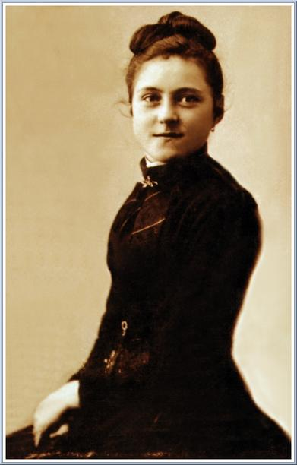
St Thérèse of Lisieux
At the age of 14, on Christmas Eve in 1886, Therese had a conversion that transformed her life. From then on, her powerful energy and sensitive spirit were turned toward love, instead of keeping herself happy.
At 15, she entered the Carmelite convent in Lisieux to give her whole life to God. She took the religious name Sister Therese of the Child Jesus and the Holy Face.

Slide 6
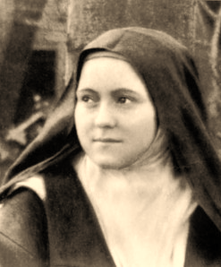
St Thérèse of Lisieux
Living a hidden, simple life of prayer, she was gifted with great intimacy with God. Through sickness and dark nights of doubt and fear, she remained faithful to God, rooted in His merciful love.
After a long struggle with tuberculosis, she died on September 30, 1897, at the age of 24. Her last words were the story of her life: "My God, I love You!"

Slide 7
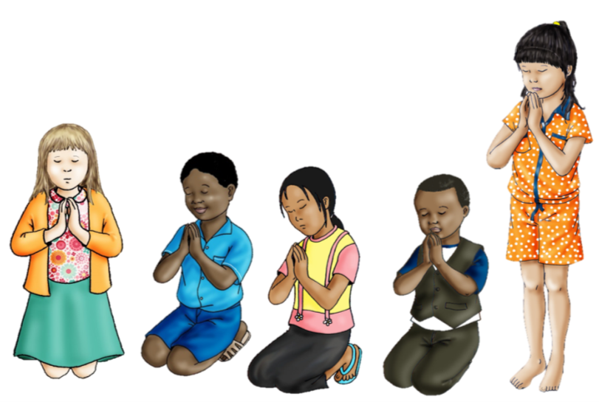
St Thérèse of Lisieux
I will seek out a means of getting to Heaven by a little way—very short and very straight, a little way that is wholly new. We live in an age of inventions; nowadays the rich need not trouble to climb the stairs, they have lifts instead. Well, I mean to try and find a lift by which I may be raised unto God, for I am too tiny to climb the steep stairway of perfection…Thine Arms, then, O Jesus, are the lift which must raise me up even unto Heaven. To get there I need not grow; on the contrary, I must remain little, I must become still less.

Slide 8
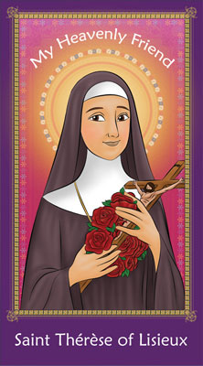
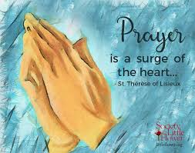
St Thérèse of Lisieux
Important dates in the life of St Therese
Birthday Baptism Death of her Mother, Zelie Guerin Pauline, her sister, enters Carmel First Communion Confirmation Audience with Pope Leo XIII Entry into Carmel Profession of Vows Death of her Father, Louis Martin Therese enters the infirmary Her Death, Entry into Heaven Her autobiography Story of a Soul is published Cause of Beatification Introduced at Rome Beatification Canonisation Declared Doctor of the Church | January 2, 1873 January 4, 1873 August 28, 1877 October 2, 1882 May 8, 1884 June 14, 1884 November 20, 1887 April 9, 1888 September 8, 1890 July 29, 1894 July 8, 1897 September 30, 1897 September 30, 1898 June 10, 1914 April 29, 1923 May 17, 1925 October 19, 1997

Slide 9
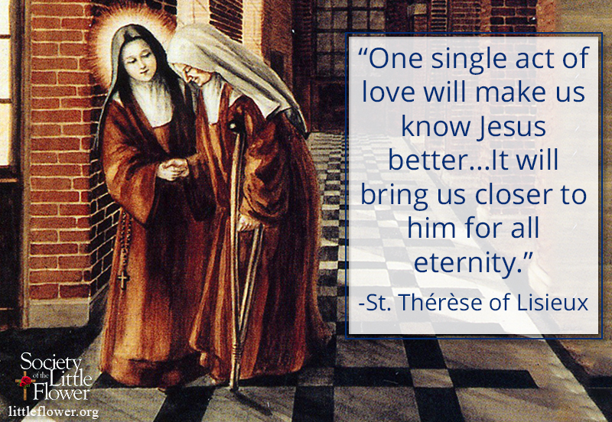
St Thérèse of Lisieux
Thérèse was Canonised on May 17, 1925 by Pope Pius XI, only 28 years after her death. All four of her sisters were still alive when heir younger sister Therese was Canonised (made a saint).
Thérèse of Lisieux is the patron saint of aviators, florists, illnesses and missions. She is also considered by Catholics to be the Patron Saint of Russia.
Her feast day is October 1. St Thérèse of Lisieux is one of the most popular saints in the history of the Catholic Church.

Slide 10
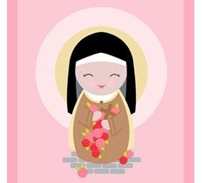
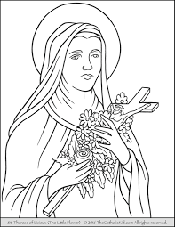
St Thérèse of Lisieux
Create your own storyboard on the life of St Thérèse of Lisieux. Remember to include information about the different stages of her life below the image that you draw. Use the facts that you have learned about her life to demonstrate your understanding and creativity.

Slide 11
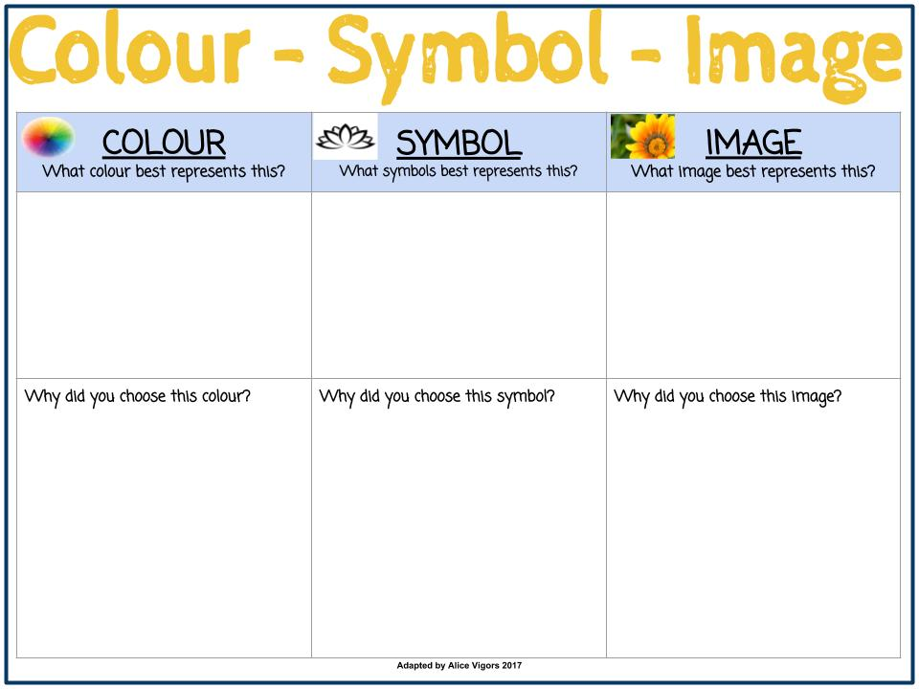
St Thérèse of Lisieux
Making Thinking Visible
Create your own colour-symbol-image poster on the life of St Thérèse.

Slide 12
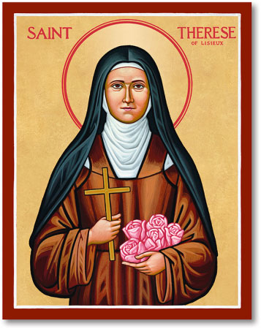
St Thérèse of Lisieux
Making Thinking Visible- Step Inside
Imagine that you were one of St Therese’s older sisters and witnessed your little sister being made a saint.
What can you see, observe or notice?
What might you know, understand, hold true or believe?
What might you care deeply about?
What might you wonder about or question?

Slide 13
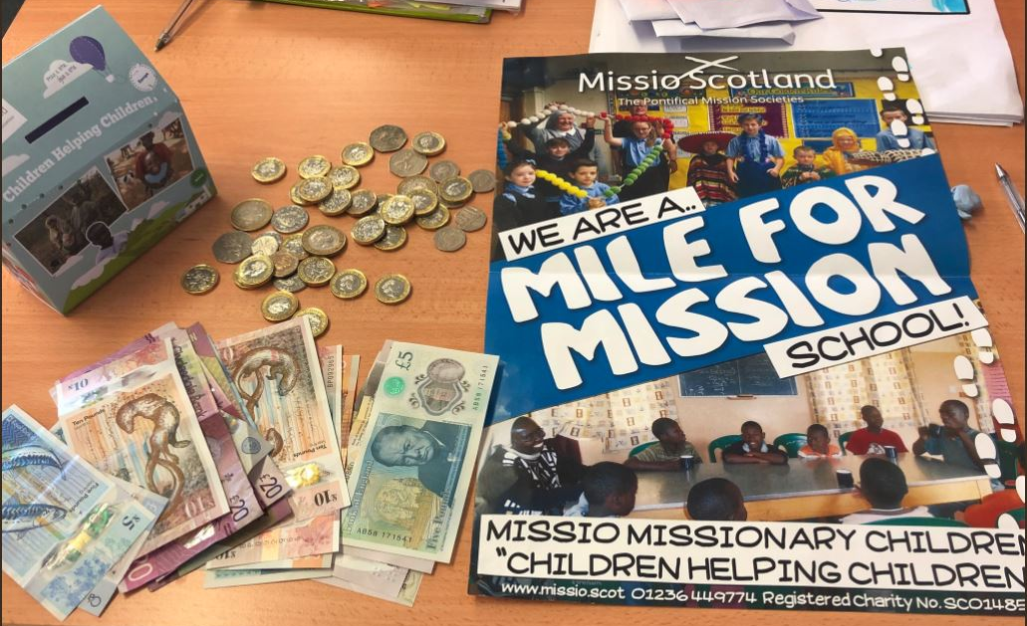
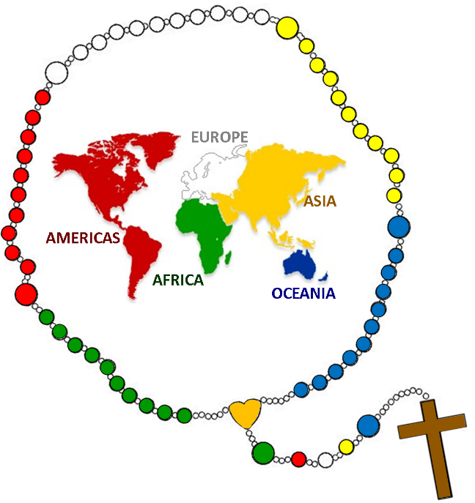
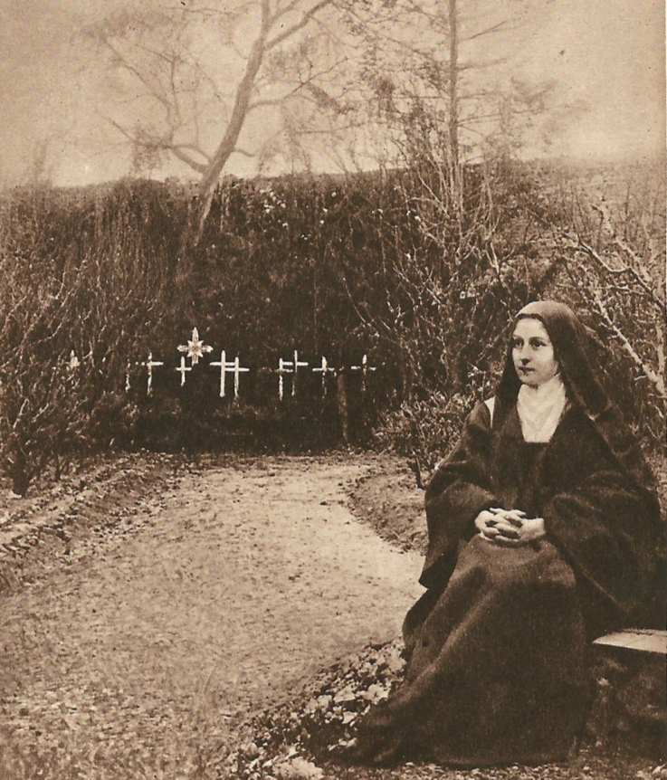
St Thérèse of Lisieux
Pray and fundraise for Missio Scotland—Help today’s missionaries support those living in poverty overseas.
Follow Thérèse’s Little Way—Miss no opportunity to be missionaries of God’s love.
Get to know Jesus—Spend time with God and by reflecting on the Gospel.

Slide 14
St Thérèse of Lisieux
In the name of the Father, and of the Son, and of the Holy Spirit. Amen.
Dearest St Therese of Lisieux, you said that you would spend your time in heaven doing good on earth. Your trust in God was complete. Pray that He may increase my trust in His goodness and mercy as I ask for the following petitions… (State your intentions) Pray for me that I, like you, may have great and innocent confidence in the loving promises of our God. Pray that I may live my life in union with God’s plan for me, and one day see the Face of God whom you loved so deeply. Saint Therese, you were faithful to God even unto the moment of your death. Pray for me that I may be faithful to our loving God. May my life bring peace and love to the world through faithful endurance in love for God our saviour. Loving God, you blessed St. Therese with a capacity for a great love. Help me to believe in your unconditional love for each of your children, especially for me. I love you, Lord. Help me to love you more! Glory be to the Father, to the Son, and to the Holy Spirit. As it was in the beginning, is now, and ever shall be, world without end. Amen.
In the name of the Father, and of the Son, and of the Holy Spirit. Amen.

