Slide 1



As Missionary Children, let’s learn more about mission and take
a trip to…ZAMBIA!

Slide 2
Links to This is our Faith
P5RERC 2-03a I can examine God’s relationship with myself and others. I have reflected on how the gift of faith can permeate my whole being.
I have studied the relationship that the Saints and holy people have with God and I can describe how faith permeates their life and mission.
P6RERC 2-10a I can reflect on the Holy Spirit’s prophetic influence.
I can identify some of the ways in which the Church works for justice and peace, by investigating the work of a missionary religious order/congregation, a project my school is twinned with, or the work of a Catholic aid agency.
I have considered how I can support this prophetic missionary work, under the guidance of the Holy Spirit.
P7RERC 2-09a I know that the Church is still missionary today, and that I share in this mission by living Gospel values such as justice, mercy, peace, compassion, faithfulness and honesty and by practising my faith sacramentally.

Slide 3
Links to other curricular areas
Task 1—HWB. Children are able to identify and share their skills and talents. I recognise that each individual has a unique blend of abilities and needs. I contribute to making my school community one which values individuals equally and is a welcoming place for all. HWB 2-10a
Task 2—Art and Design. Children are able to look at a painting of Jesus and discuss what they see, they can share thoughts and feelings about the painting. Inspired by a range of stimuli, I can express and communicate my ideas, thoughts and feelings through activities within art and design. EXA 2-05a
Task 3—Social Studies. Children to learn about Zambia and help given to those in need there. Able to discuss similarities and differences in cultures Scotland/Zambia. Able to place Zambia on a map. To extend my mental map and sense of place, I can interpret information from different types of maps and am beginning to locate key features within Scotland, UK, Europe or the wider world. SOC 2-14a By comparing the lifestyle and culture of citizens in another country with those of Scotland, I can discuss the similarities and differences. SOC 2-19a
Task 4—HWB. Children able to represent skills and qualities that they contribute to their class and school which is inclusive and caring towards others. I recognise that each individual has a unique blend of abilities and needs. I contribute to making my school community one which values individuals equally and is a welcoming place for all. HWB 2-10a

Slide 4

Learning intentions
We are learning:
To identify the biggest religion in the world.
To explain what ‘missionary’ means.
To describe who Missio are and the work they do.
To locate Zambia on a map and explain what their flag represents.

Slide 5
Success criteria
I will be able to identify which religion is the largest in the world and where this religion is practised.
I can describe what a missionary is, and list some of the skills and qualities that I think help to make a good missionary.
I can describe who Missio are and some of the work they carry out in Scotland and across the world.
I can locate Zambia on a map of Africa and I can describe significant aspects of their flag.

Slide 6
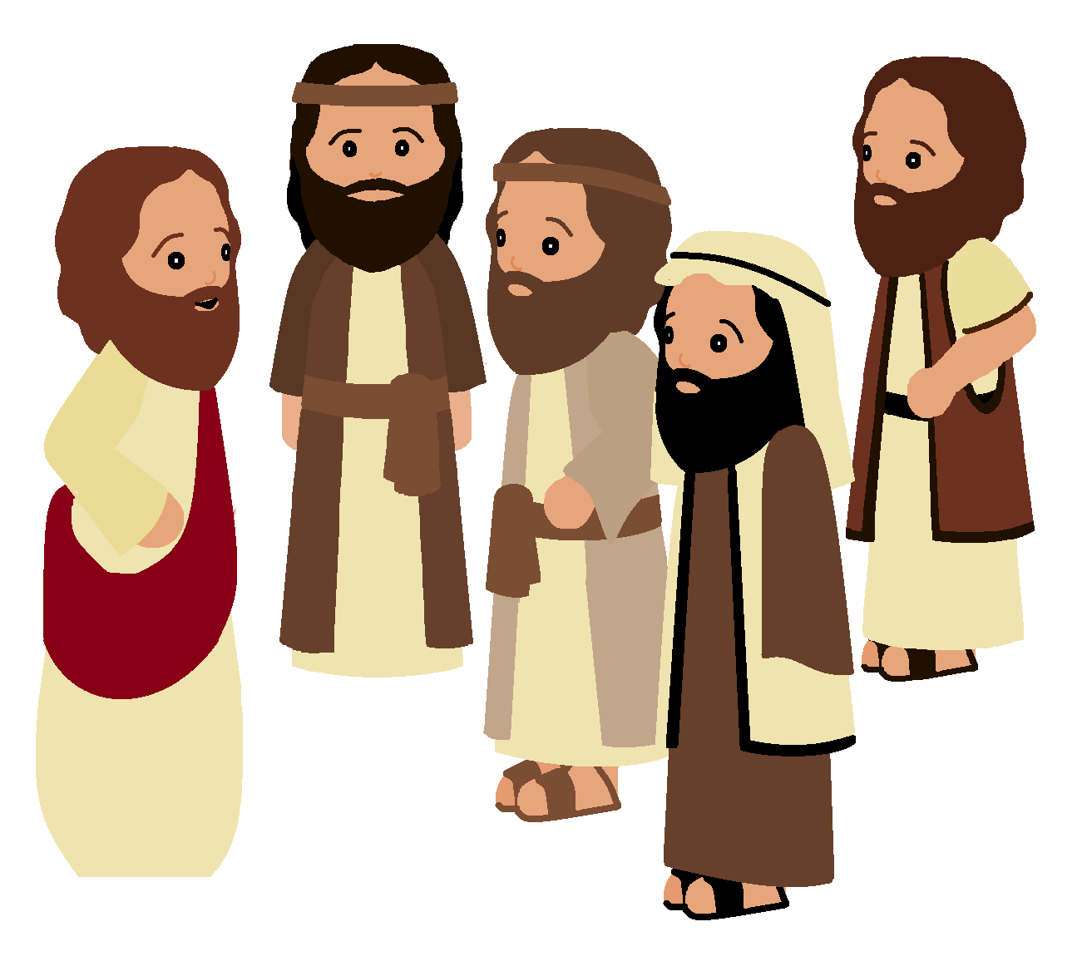
What is Christianity?
Christianity is the world's largest religion, with about 2.3 billion followers worldwide. It is based on the teachings of Jesus Christ who lived in modern day Israel 2000 years ago.
All of Jesus’ disciples followed His instruction to spread the word of God throughout the world. They travelled as far as they could telling people all about God’s love and spreading the word of God.
https://www.bbc.co.uk/teach/class-clips-video/religious-studies-ks2-what-is-christianity/znshvk7

Slide 7
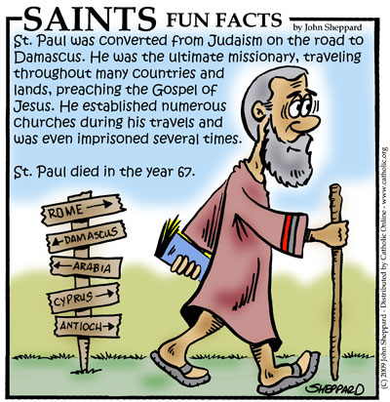
What is a missionary?
St Paul was one of the great missionaries of the Christian faith. This means that he spread the teachings of Jesus wherever he travelled and he travelled a great many places before his time on earth came to an end! We know the places where he set up Christian churches because he sent letters back to these people. These places were in modern day Turkey, Greece and Italy.
https://www.youtube.com/watch?v=R0p0W_Zbt1s
A missionary is a person who spreads God’s love

Slide 8
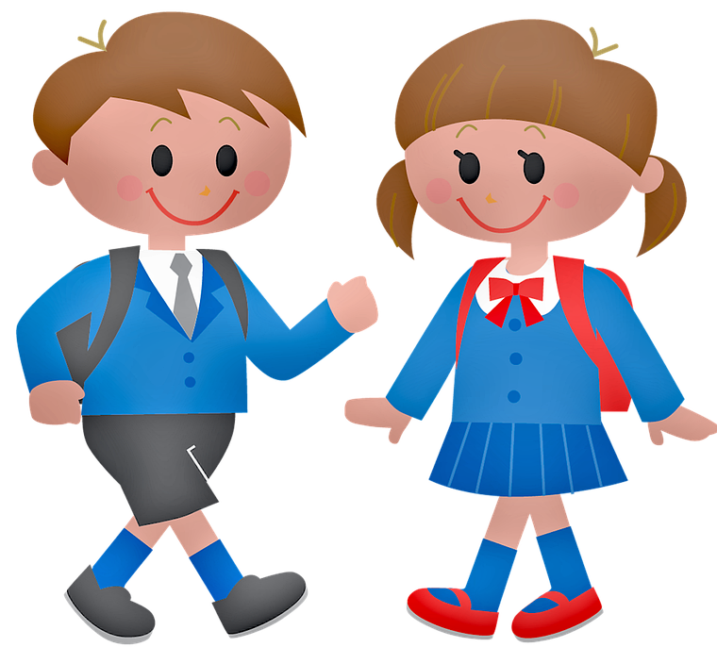
Task 1
Your task is to step into the shoes of one of the early followers of Jesus, maybe St Paul, who spread God’s love and word across the world. What sort of gifts or talents do you think would be important to help you to spread God’s love?
For example do you think that you would have to be brave? Would you have to be clever? Draw yourself and list the gifts or talents that you think you would need.
Brave…
Writes letters…
Kind…

Slide 9
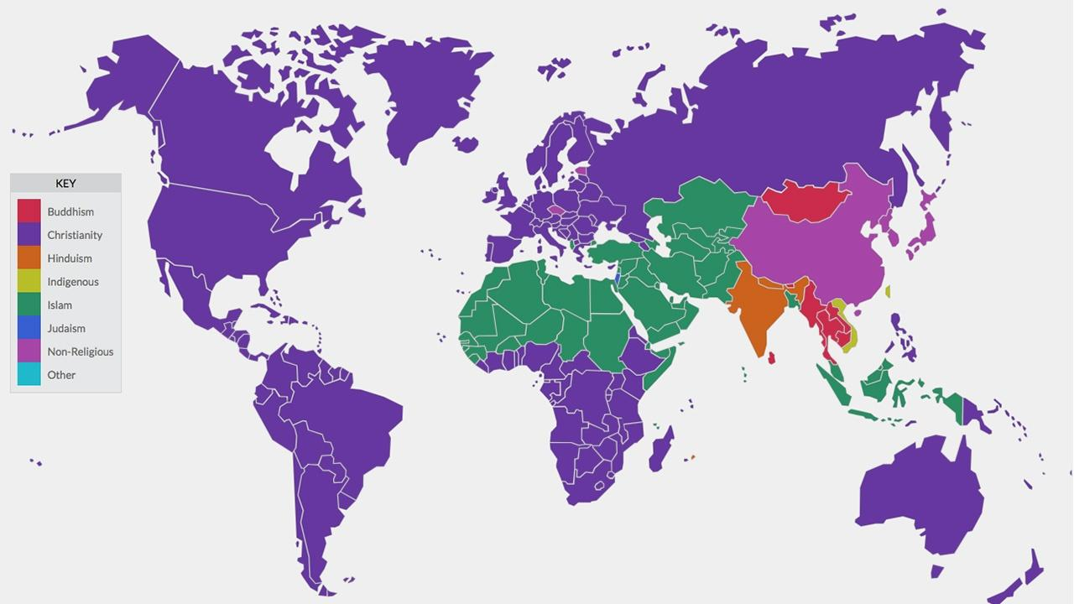
A worldwide commitment
Christianity is found on every continent in the world because Jesus’ followers told as many people as they could all about God’s love.
We are called to spread God’s love throughout the world by being missionaries. We can do this very close to home or very far away.
This map shows the largest religion in each country of the world

Slide 10
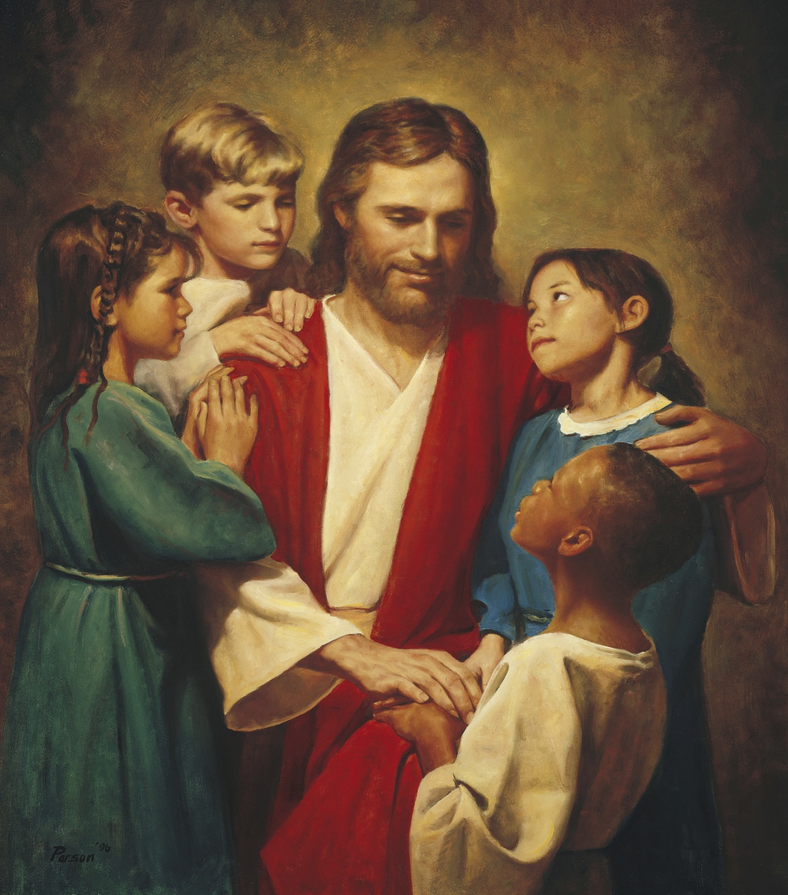
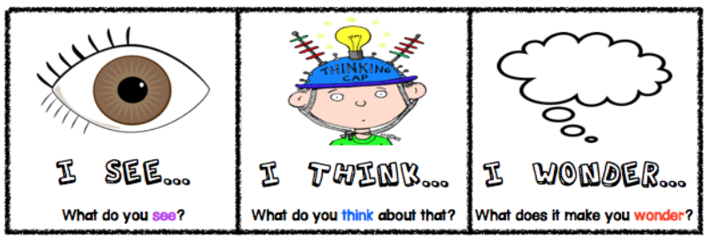
Task 2
Take a very close look at this picture. Write down something you see, something that it makes you think about and something that it makes you wonder about.

Slide 11
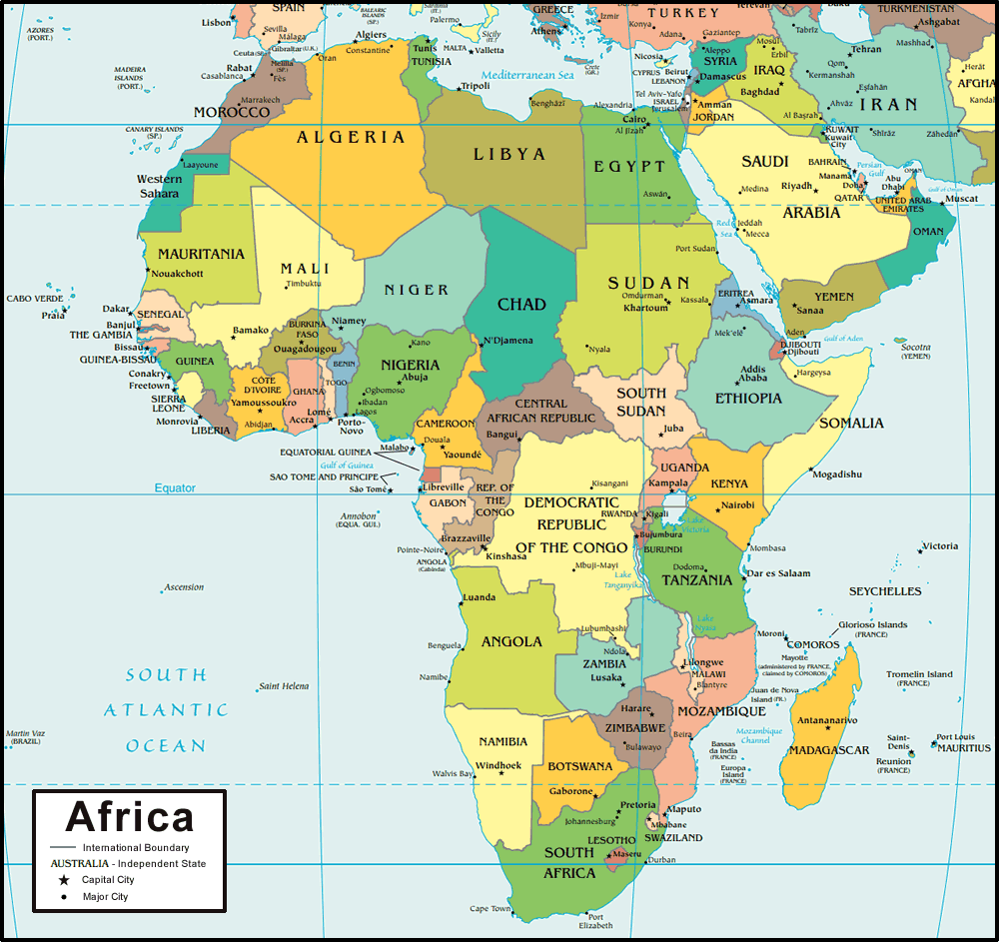
Task 3
Christianity is growing fastest is the continent of Africa. There are 54 countries in Africa.
In the past there were lots of missionaries from many countries in Europe who travelled to Africa spreading God’s love. However anyone who spreads God’s love is a missionary they don’t have to travel far away to do so. Many people are missionaries in their own communities because there are lots of ways that people can show God’s love.
Describe ways that you can be a missionary and show God’s love at home, at school and in the community.

Slide 12
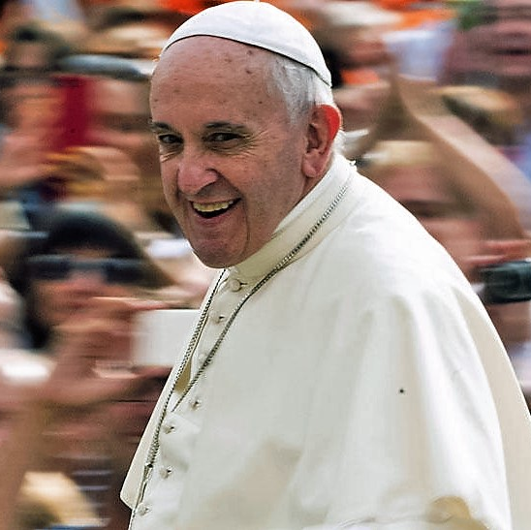
The Pope’s Charity—Missio
There are lots of missionaries all over the world who do their very best to tell people about Jesus and spread God’s love. The Pope strives to help people spread the Good News about God’s love. One way that the Pope helps his missionaries is through a charity called Missio. Missio raises money to help people spread God’s love all over the world in lots of different ways.
https://www.missioscotland.com/what-is-missio-scotland

Slide 13
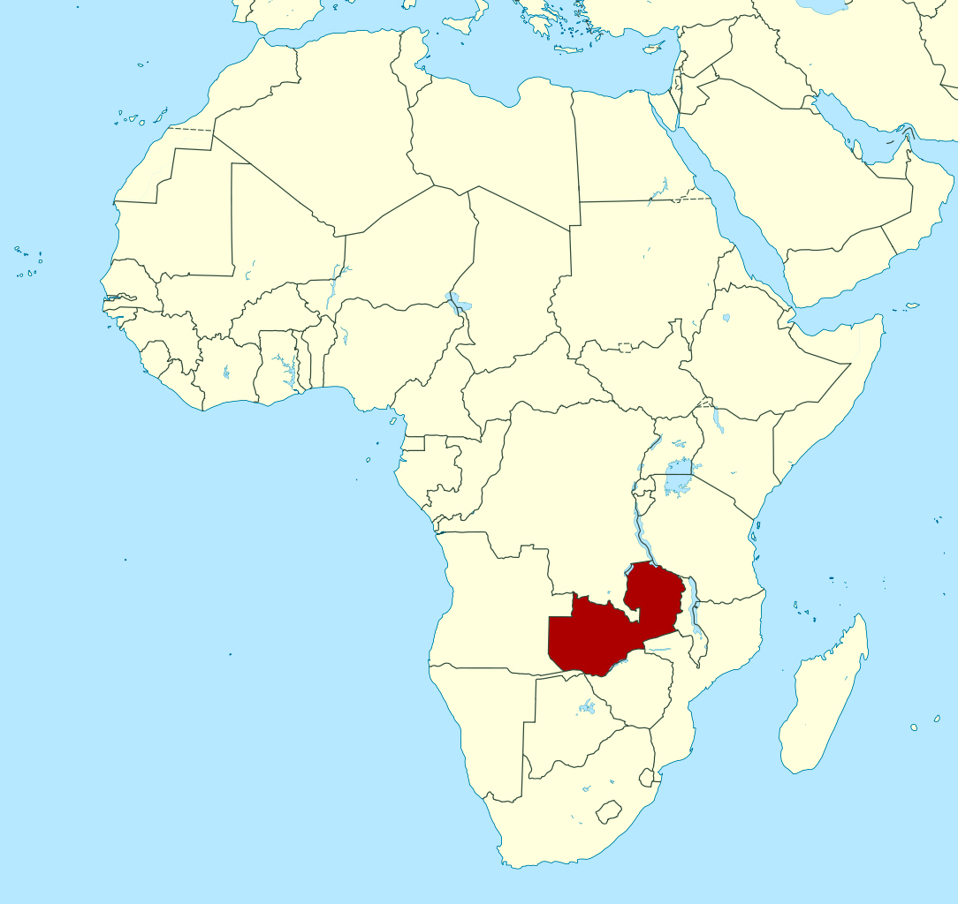
Missio in Zambia
One of the countries in Africa where Missio helps to spread God’s love is Zambia. Missio helps missionaries in Zambia to spread God’s love in their own communities. Missio does lots of things to try to help spread God’s love:
Feeds poor and disadvantaged children
Provides fresh, clean water
Provides shelter
Provides hospitals and access to treatment
Builds schools and provides access to education

Slide 14
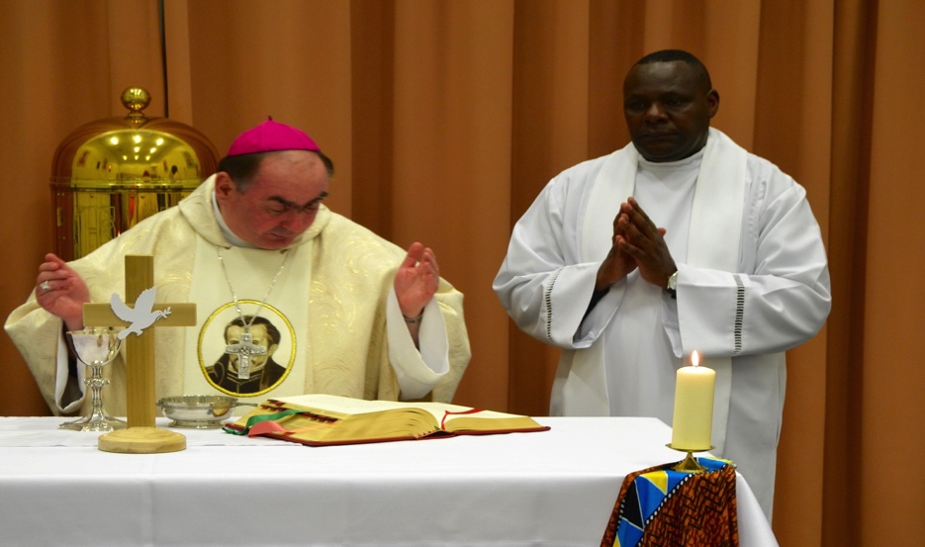
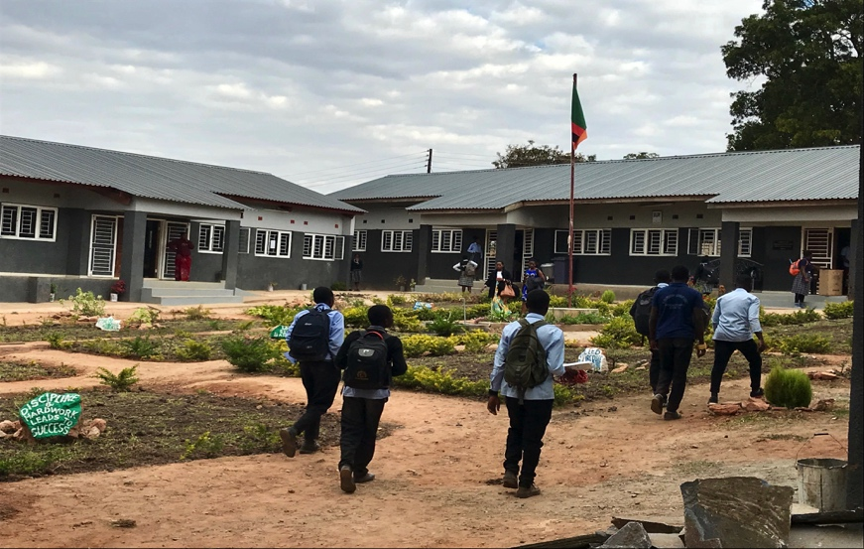
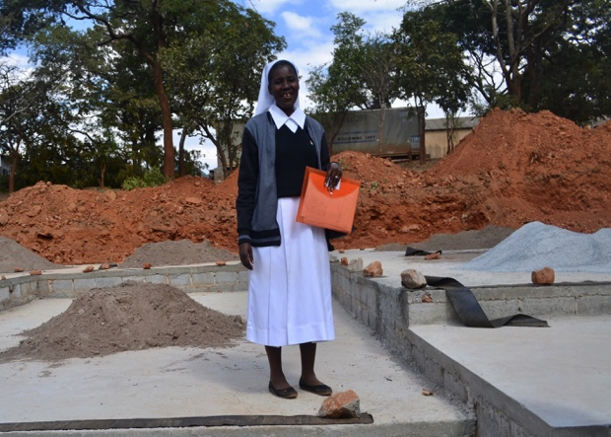
Mission at work in Zambia
Fr Bernard Makadani Zulu (above with Bishop Toal) is a Zambian priest who spent five years working with Missio Scotland and was also parish priest of St Bernard’s, Shawhead in Motherwell Diocese. He was also the National Director of the Pontifical Mission Societies in Zambia and oversaw all the supported projects there.
In the Lusaka West region of Zambia, there was once no Secondary School for miles around, meaning that for some children, their education ended after primary school.
However, thanks to your fundraising efforts, Missio Scotland helped to build the first classroom block in St Columba’s High School (above) —named as result of support from Scotland. The school has now expanded and is building more classroom blocks much to the delight of Sr Veronica Nyoni, whose Teresian Sisters help run the school.

Slide 15
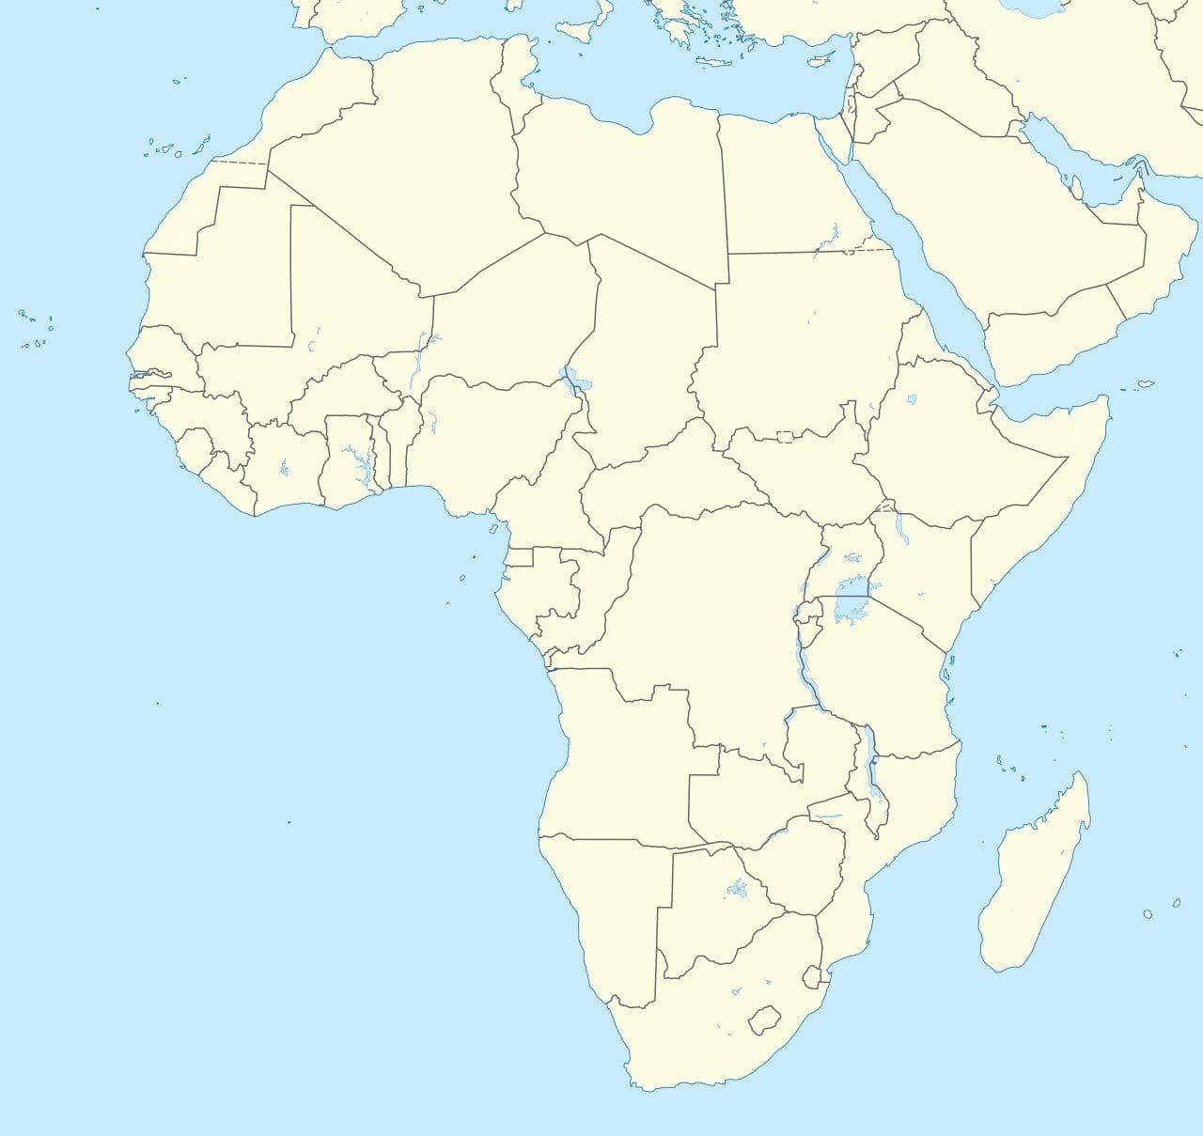
Task 4
Create your own map of Africa. Try to put all of the countries names in the correct place in your map.

Slide 16

The flag of Zambia
This is the flag of Zambia. The different colours and symbols in the flag show important facts about the country.
Green stands for Zambia’s lush grasslands, red for Zambia’s struggle for freedom, black for the Zambian people, and orange for the land's natural resources and mineral wealth. There is also an eagle flying above the coloured stripes and this is to represent the people's ability to rise above the nation's problems.

Slide 17
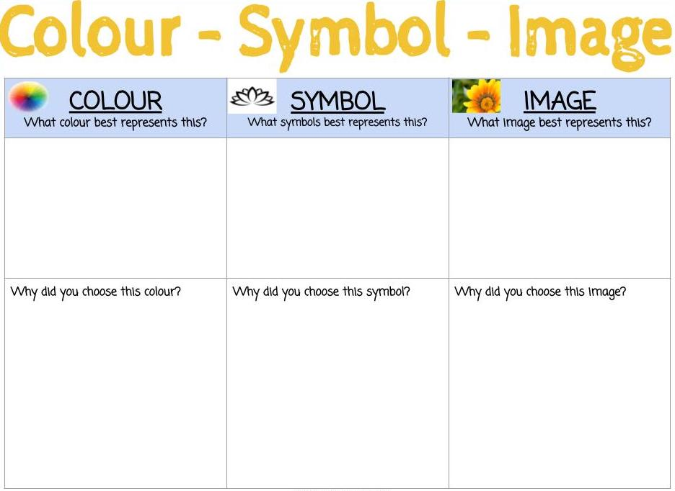
Design your own mission flag (1)
Design a flag that could be your ‘Mission’ flag. Choose a colour/colours, a symbol and an image that you think best shows ways that you spread God’s love. (Go to the next slide for a template)

Slide 18
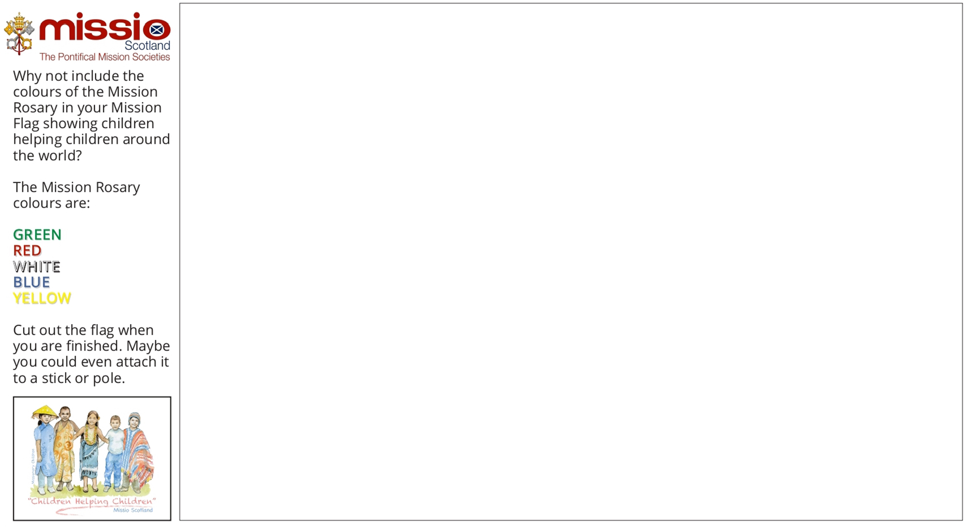
Design your own mission flag (2)

Slide 19
Further activities
Complete one of our Zambia Factfile worksheets and showcase your increased knowledge of the country!
Write a Postcard From Zambia, using our worksheet, and let friends and family back home imagine what the country is like.
Fill in our Zambia Coin Map to show that you care for mission work in the country.
Visit the Where We Work photo album on our Facebook page (www.facebook.com/missioscotland) and try and identify some of the projects supported in Zambia.
Create a Zambia Wall Display in your classroom, bringing together facts and figures that you have learned about the country and perhaps add some artwork related to the country and/or your Mission Flags.

Slide 20

www.missioscotland.com/schools

