Slide 1
Let’s learn all about… SAINT JOSEPH!

Slide 2
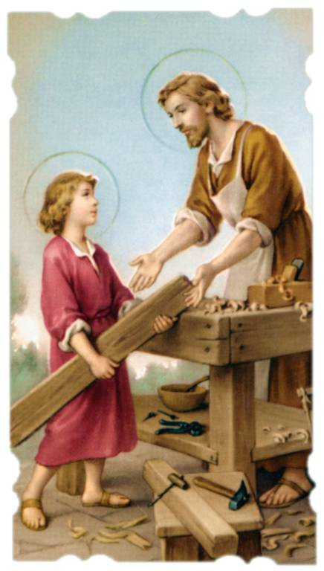
Learn about Saint Joseph
Saint Joseph was the husband of Our Lady (Mary) the Mother of Jesus.
He was the father figure in Jesus’ young life. We learn that he was a good man who worked hard a carpenter to provide for his family.
Each time St Joseph is mentioned in the Gospels he is extremely important for Jesus. The Gospels are the ‘Good News’ biographies written about the life of Jesus. They were written by Matthew, Mark, Luke and John.

Slide 3
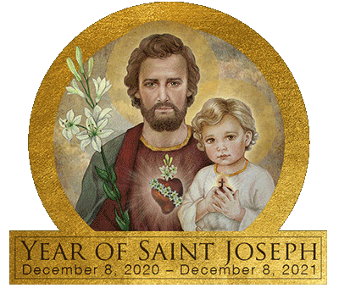
Learn about Saint Joseph
St Joseph is the Patron of the Catholic Church. This means that he is a guardian or protector for Catholics all over the world.
We celebrate the importance of St Joseph on March 19. This is called a feast day.
This year, Pope Francis has asked all Catholics to celebrate St Joseph and learn more about him.

Slide 4
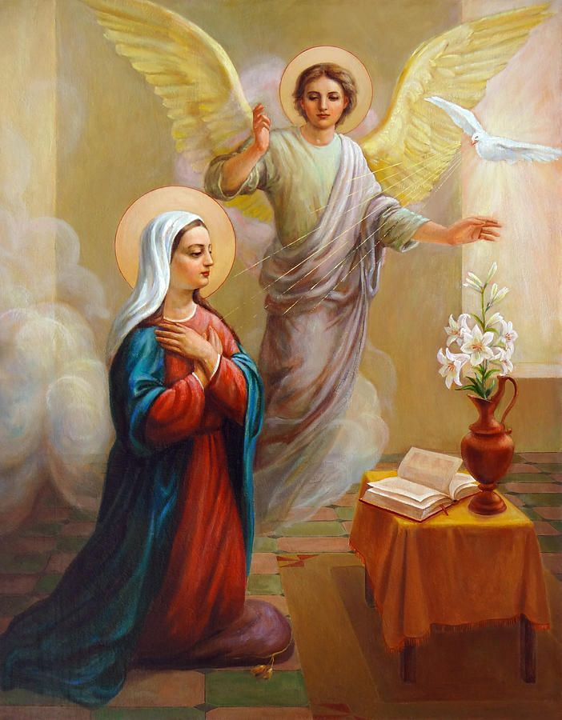
The Annunciation
The Mother of Jesus, who was named Mary, was chosen especially for the task of bringing Jesus into the world. While She was waiting to marry and live with Her new husband Joseph, She was visited by the Angel Gabriel in the small town of Galilee.
The angel told Mary that God had chosen Her for an extremely important task. This was an invitation to bring the Child Jesus into the world. Catholics refer to this visit by the angel to Mary (Our Lady) as ‘The Annunciation.’ However, without St Joseph none of this would have been possible!
Annunciation To The Blessed Virgin Mary by Svitozar Nenyuk

Slide 5
The Annunciation
There was a serious problem for Mary because She was not yet married, but only engaged to Joseph. If he found out that She was pregnant, then the life of Our Lady could be in danger because in that part of the world, at that time, She could have been put to death for having a baby before She was married.
Joseph, being a good man, decided that he did not want to cause Mary any harm and decided to call off the wedding and allow Her to move somewhere else. Fortunately, the following happened to Joseph, which changed their lives forever:
https://www.youtube.com/watch?v=BWZ48mG95Xc

Slide 6
Tasks 1
Choose one of the following tasks: 1) Create a poster about St Joseph
2) Write a short letter to Pope Francis explaining why St Joseph is important.
3) Colour the poster that your teacher gives you.

Slide 7
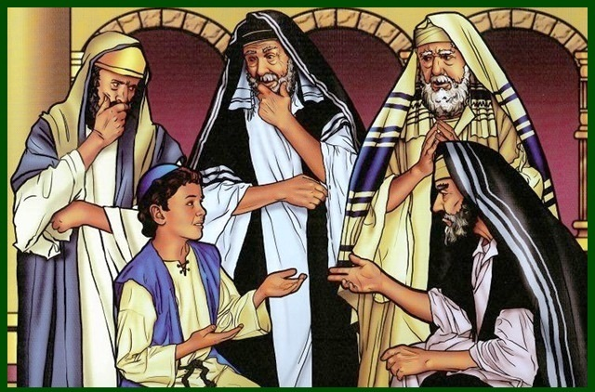
The Child Jesus in the Temple
https://www.youtube.com/watch?v=il9Z39tDhGE

Slide 8
Tasks 2
After watching the video clip of the finding of the Child Jesus in the Temple, complete the following tasks:
Task A
Imagine that you were Joseph and the 12-year-old Jesus had gone missing. You have been searching for Him and arrive at the temple.
What can Joseph see, observe or notice?
What might Joseph know, understand, hold true or believe?
What might Joseph care deeply about?
What might Joseph wonder about or question?
Task B
Has there ever been a time in your life when you went missing or one of your family went missing?
What age were you when this happened?
Where did it happen?
How were you found?
How did your parents/grandparents react when they found you?
Did you learn anything important after getting lost?

Slide 9
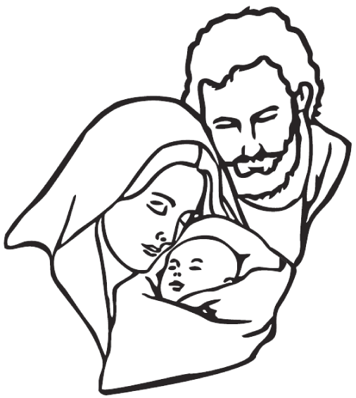
Prayer and Task 3
YEAR OF ST JOSEPH PRAYER
Hail, Guardian of the Redeemer, Spouse of the Blessed Virgin Mary. To you God entrusted his only Son; in you Mary placed her trust; with you Christ became man.
Blessed Joseph, to us too, show yourself a father and guide us in the path of life. Obtain for us grace, mercy, and courage, and defend us from every evil. Amen.
Task
You can either decoratively produce a version of the prayer to St Joseph or create your own prayer to St Joseph. Remember to include why he is important for Catholics all over the world.

