Slide 1
As Missionary Children, let’s learn more about mission and take a trip to… SIERRA LEONE!

Slide 2
Links to This is our Faith
P5RERC 2-03a I can examine God’s relationship with myself and others. I have reflected on how the gift of faith can permeate my whole being.
I have studied the relationship that the Saints and holy people have with God and I can describe how faith permeates their life and mission.
P6RERC 2-10a I can reflect on the Holy Spirit’s prophetic influence.
I can identify some of the ways in which the Church works for justice and peace, by investigating the work of a missionary religious order/congregation, a project my school is twinned with, or the work of a Catholic aid agency.
I have considered how I can support this prophetic missionary work, under the guidance of the Holy Spirit.
P7RERC 2-09a I know that the Church is still missionary today, and that I share in this mission by living Gospel values such as justice, mercy, peace, compassion, faithfulness and honesty and by practising my faith sacramentally.

Slide 3
Links to other curricular areas
Task 1—HWB. Children are able to identify and share their skills and talents. I recognise that each individual has a unique blend of abilities and needs. I contribute to making my school community one which values individuals equally and is a welcoming place for all. HWB 2-10a
Task 2—Art and Design. Children are able to look at a painting of Jesus and discuss what they see, they can share thoughts and feelings about the painting. Inspired by a range of stimuli, I can express and communicate my ideas, thoughts and feelings through activities within art and design. EXA 2-05a
Task 3—Social Studies. Children to learn about Sierra Leone and help given to those in need there. Able to discuss similarities and differences in cultures Scotland/Sierra Leone. Able to place Sierra Leone on a map. To extend my mental map and sense of place, I can interpret information from different types of maps and am beginning to locate key features within Scotland, UK, Europe or the wider world. SOC 2-14a By comparing the lifestyle and culture of citizens in another country with those of Scotland, I can discuss the similarities and differences. SOC 2-19a
Task 4—HWB. Children able to represent skills and qualities that they contribute to their class and school which is inclusive and caring towards others. I recognise that each individual has a unique blend of abilities and needs. I contribute to making my school community one which values individuals equally and is a welcoming place for all. HWB 2-10a

Slide 4
Learning intentions
We are learning:
To identify the biggest religion in the world.
To explain what ‘missionary’ means.
To describe who Missio are and the work they do.
To locate Sierra Leone on a map and explain what their flag represents.

Slide 5
Success criteria
I will be able to identify which religion is the largest in the world and where this religion is practised.
I can describe what a missionary is, and list some of the skills and qualities that I think help to make a good missionary.
I can describe who Missio are and some of the work they carry out in Scotland and across the world.
I can locate Sierra Leone on a map of Africa and I can describe significant aspects of their flag.

Slide 6
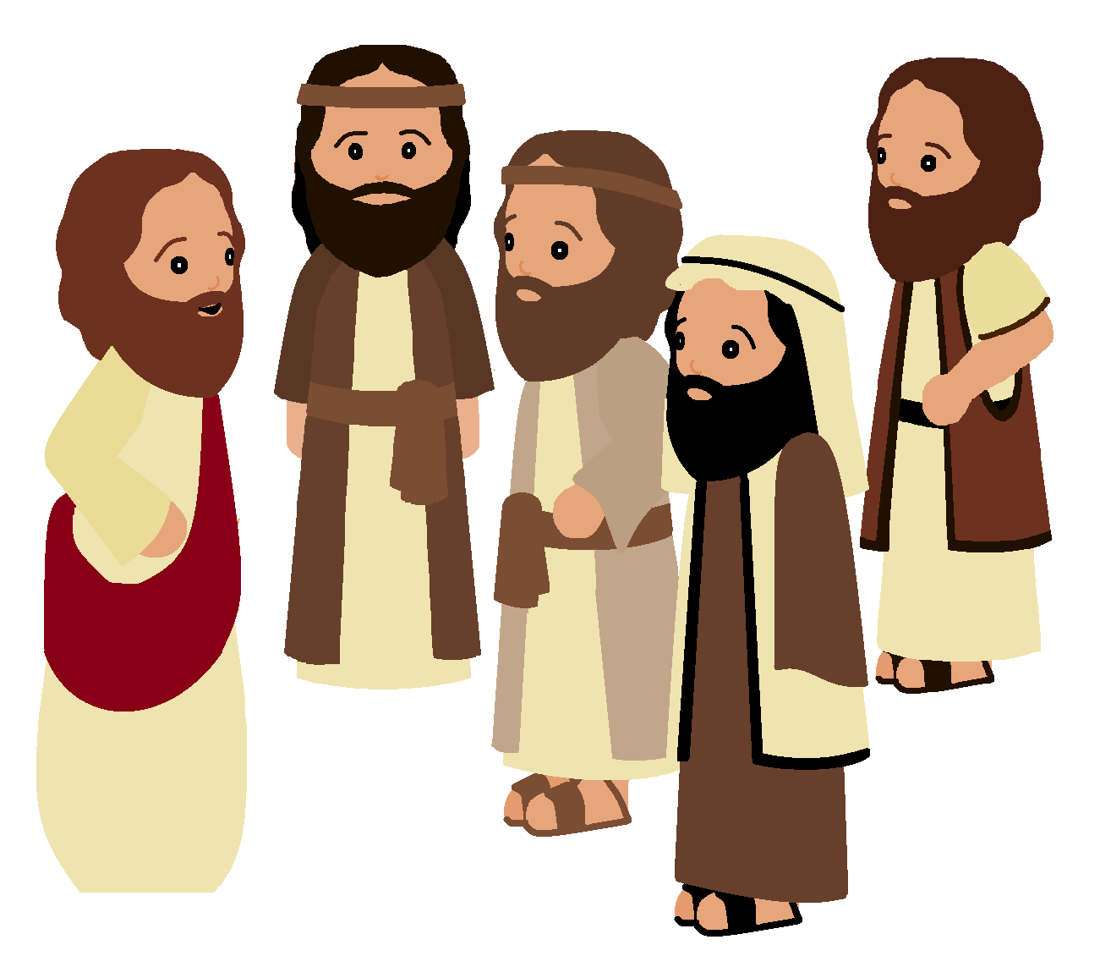
What is Christianity?
Christianity is the world's largest religion, with about 2.3 billion followers worldwide. It is based on the teachings of Jesus Christ who lived in modern day Israel 2000 years ago.
All of Jesus’ disciples followed His instruction to spread the word of God throughout the world. They travelled as far as they could telling people all about God’s love and spreading the word of God.
https://www.bbc.co.uk/teach/class-clips-video/religious-studies-ks2-what-is-christianity/znshvk7

Slide 7
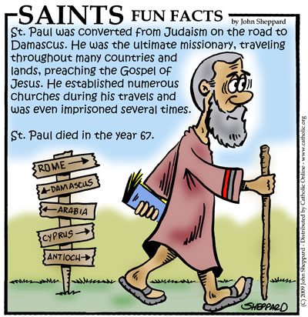
What is a missionary?
St Paul was one of the great missionaries of the Christian faith. This means that he spread the teachings of Jesus wherever he travelled and he travelled a great many places before his time on earth came to an end! We know the places where he set up Christian churches because he sent letters back to these people. These places were in modern day Turkey, Greece and Italy.
https://www.youtube.com/watch?v=R0p0W_Zbt1s
A missionary is a person who spreads God’s love

Slide 8
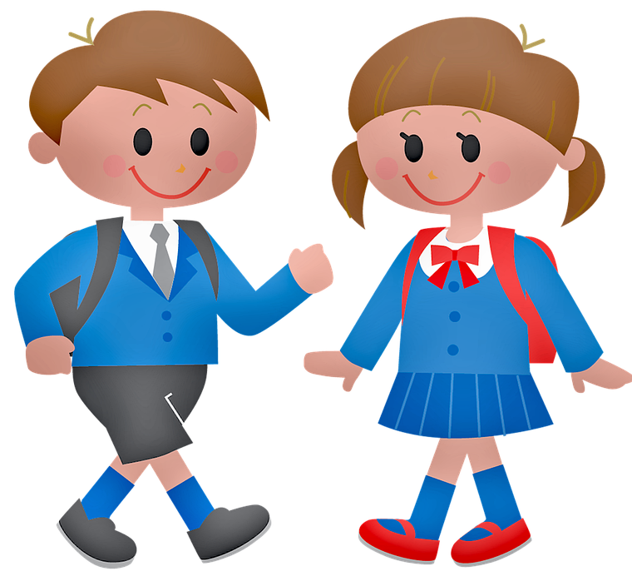
Task 1
Your task is to step into the shoes of one of the early followers of Jesus, maybe St Paul, who spread God’s love and word across the world. What sort of gifts or talents do you think would be important to help you to spread God’s love?
For example do you think that you would have to be brave? Would you have to be clever? Draw yourself and list the gifts or talents that you think you would need.
Brave…
Writes letters…
Kind…

Slide 9
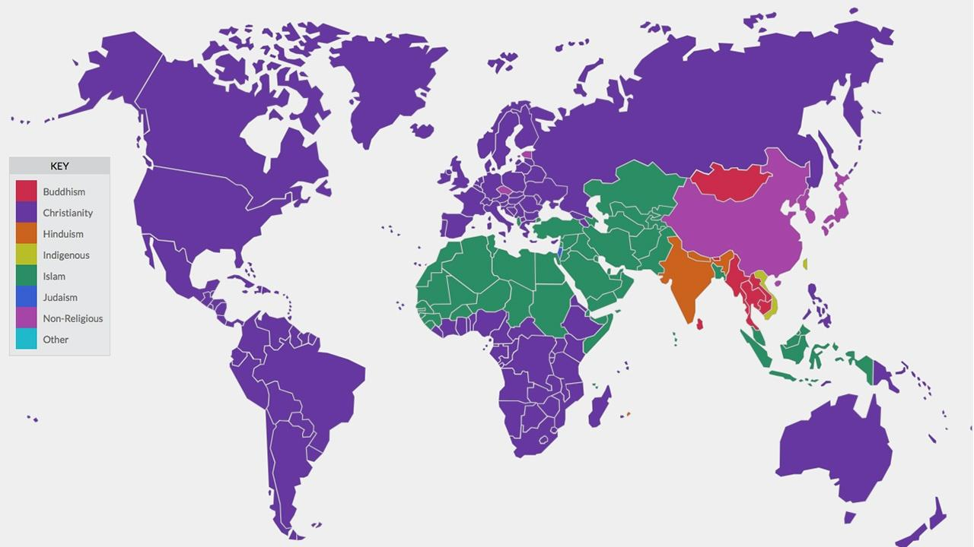
A worldwide commitment
Christianity is found on every continent in the world because Jesus’ followers told as many people as they could all about God’s love.
We are called to spread God’s love throughout the world by being missionaries. We can do this very close to home or very far away.
This map shows the largest religion in each country of the world

Slide 10
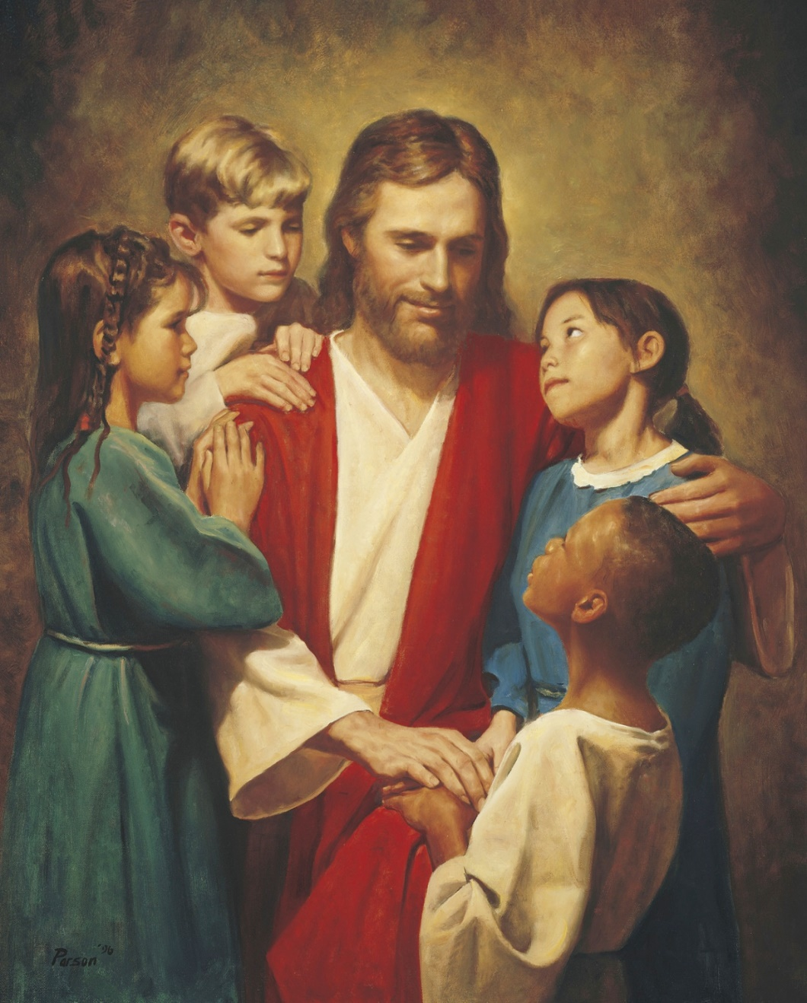
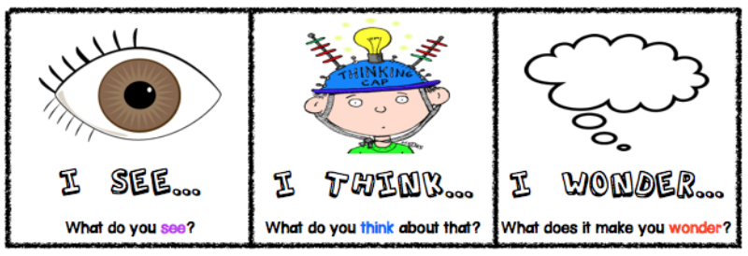
Task 2
Take a very close look at this picture. Write down something you see, something that it makes you think about and something that it makes you wonder about.

Slide 11
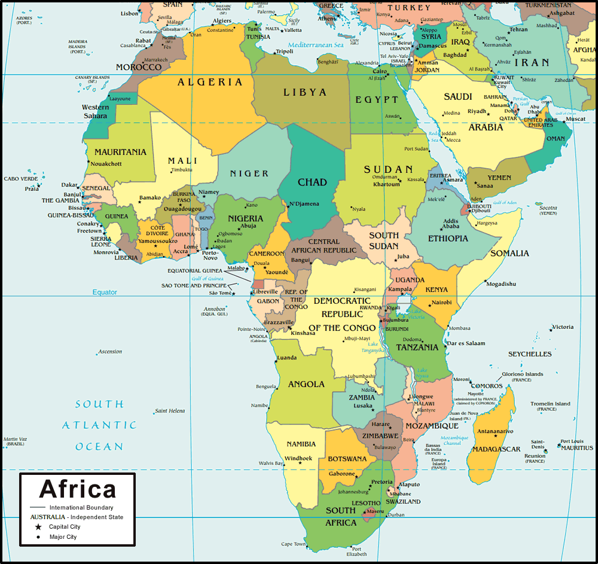
Task 3
Christianity is growing fastest is the continent of Africa. There are 54 countries in Africa.
In the past there were lots of missionaries from many countries in Europe who travelled to Africa spreading God’s love. However anyone who spreads God’s love is a missionary they don’t have to travel far away to do so. Many people are missionaries in their own communities because there are lots of ways that people can show God’s love.
Describe ways that you can be a missionary and show God’s love at home, at school and in the community.

Slide 12
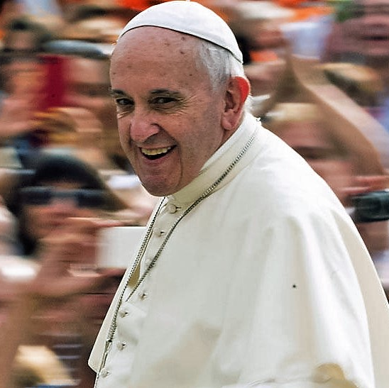
The Pope’s Charity—Missio
There are lots of missionaries all over the world who do their very best to tell people about Jesus and spread God’s love. The Pope strives to help people spread the Good News about God’s love. One way that the Pope helps his missionaries is through a charity called Missio. Missio raises money to help people spread God’s love all over the world in lots of different ways.
https://www.missioscotland.com/what-is-missio-scotland

Slide 13
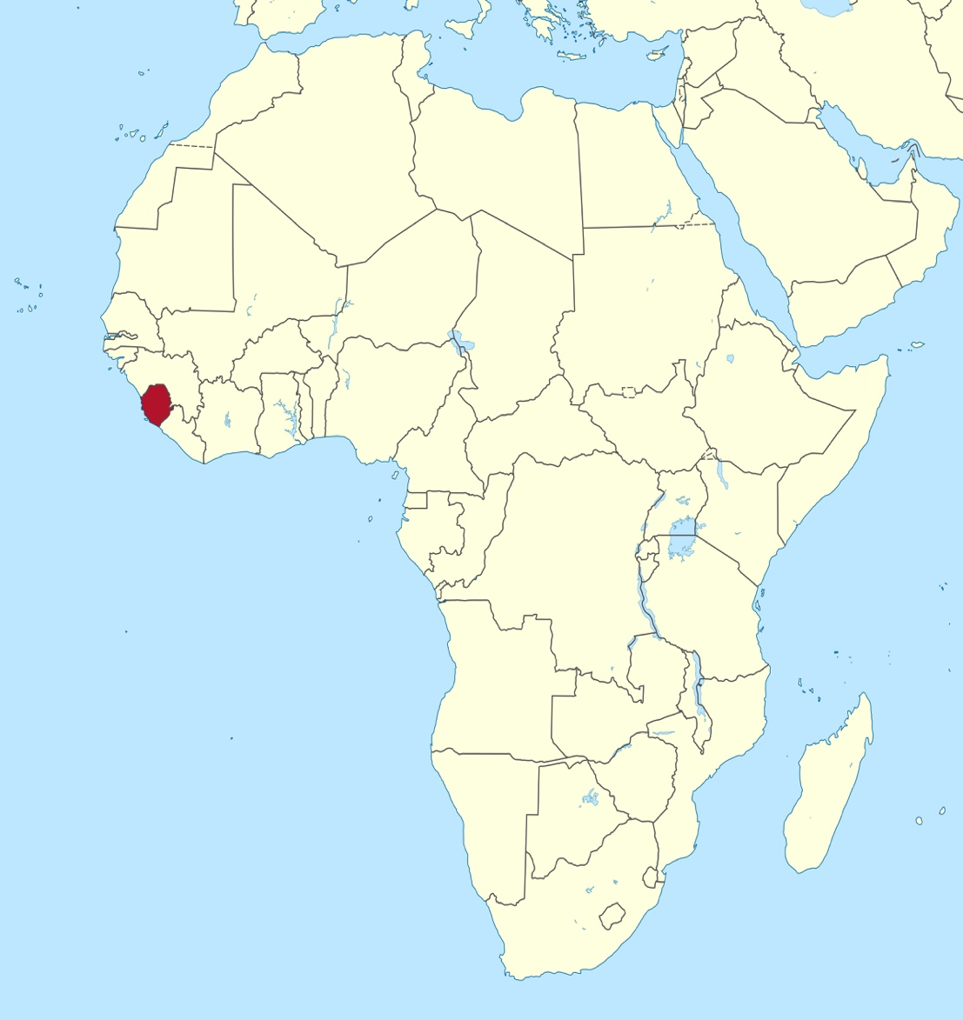
Missio in Sierra Leone
One of the countries in Africa where Missio helps to spread God’s love is Sierra Leone. Missio helps missionaries in Sierra Leone to spread God’s love in their own communities. Missio does lots of things to try to help spread God’s love:
Feeds poor and disadvantaged children
Provides fresh, clean water
Provides shelter
Provides hospitals and access to treatment
Builds schools and provides access to education

Slide 14
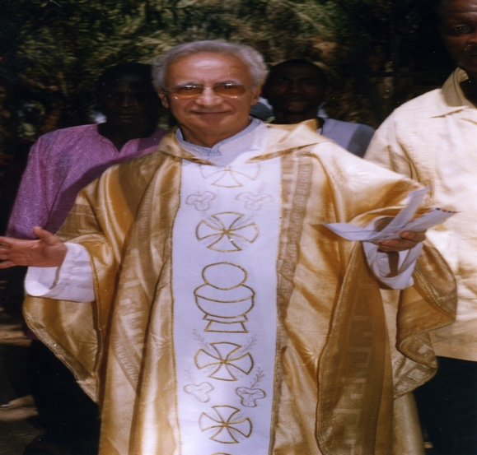
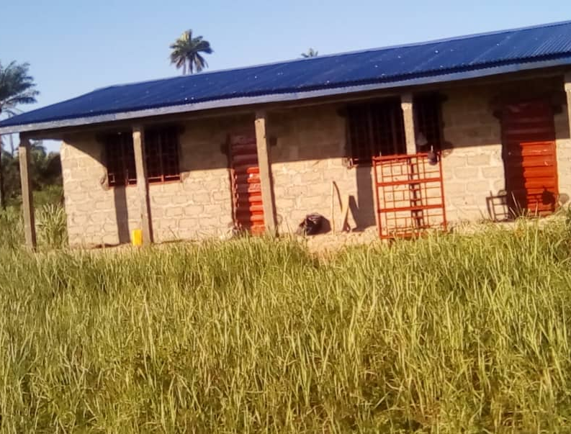
Mission at work in Sierra Leone
In Africa, there are many challenges related to education. In Sierra Leone, poverty and war impacted upon the education system. However thanks to missionaries like Scottish-based Xaverian Father, Fr Eugenio Montesi (right), the situation has improved.
Fr Montesi’s example inspired former parishioner and student Hilton Santigue Kamara (below) to become a teacher and he is now headteacher at the Love of God Schools Complex in Calaba Town, a suburb of the country’s capital Freetown.
Thanks to your support, Missio Scotland has been able to help fund the construction of new school buildings and classrooms at Hilton’s school.
In Sierra Leone, 45% of education is now in the hands of missionaries. Before the Xaverians arrived in the country, there were no primary or secondary schools, now there are thousands of primary schools, lots of secondary schools, four teacher training colleges and a university! It’s no wonder that missionaries like Fr Montesi are still loved and admired there!

Slide 15
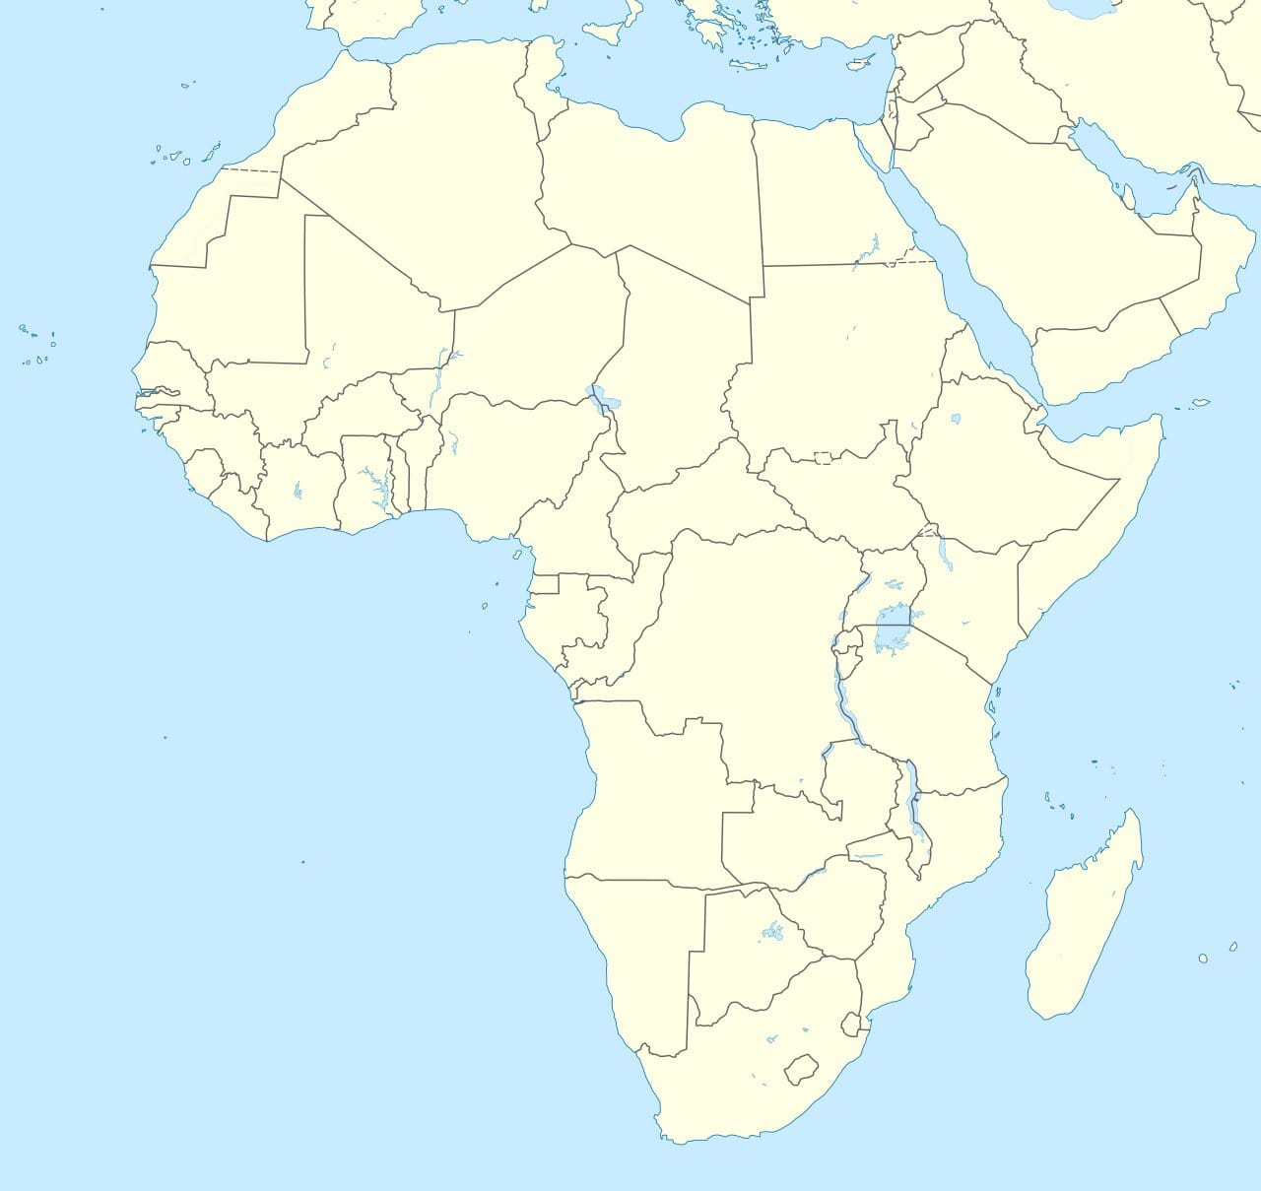
Task 4
Create your own map of Africa. Try to put all of the countries names in the correct place in your map.

Slide 16
The flag of Sierra Leone
This is the flag of Sierra Leone. The different colours and symbols in the flag show important facts about the country.
The flag is made of three coloured horizontal bands—green, white and blue. The green band represents Sierra Leone’s natural resources—specifically its agriculture and mountains. The white band represents unity and justice. The blue band represents the natural harbour of the capital city, Freetown, as well as the country’s hope of contributing to world peace.

Slide 17
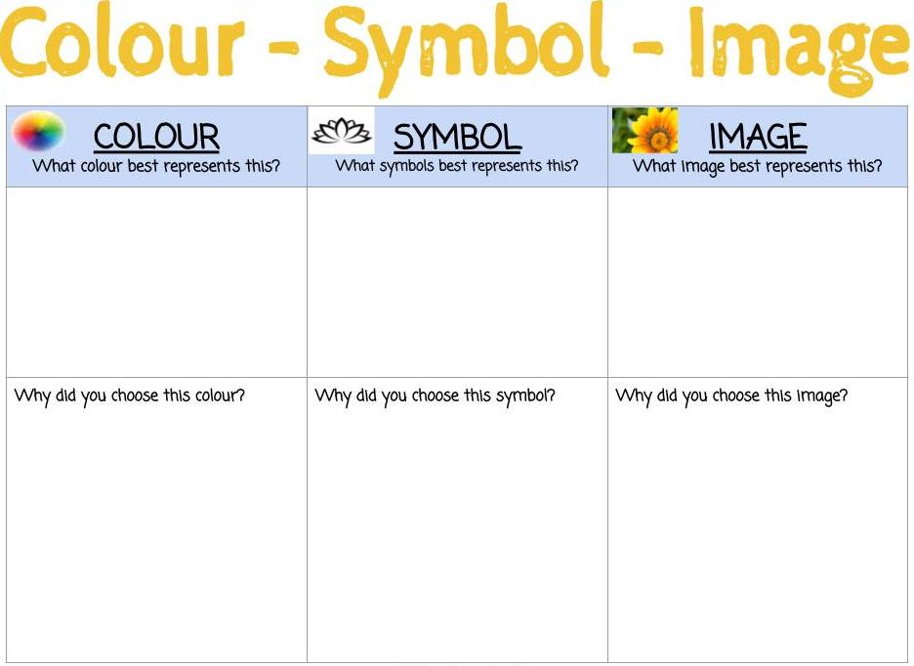
Design your own mission flag (1)
Design a flag that could be your ‘Mission’ flag. Choose a colour/colours, a symbol and an image that you think best shows ways that you spread God’s love. (Go to the next slide for a template)

Slide 18
Design your own mission flag (2)

Slide 19
Further activities
Complete one of our Sierra Leone Factfile worksheets and showcase your increased knowledge of the country!
Write a Postcard From Sierra Leone, using our worksheet, and let friends and family back home imagine what the country is like.
Fill in our Sierra Leone Coin Map to show that you care for mission work in the country.
Visit the Where We Work photo album on our Facebook page (www.facebook.com/missioscotland) and try and identify some of the projects supported in Sierra Leone.
Create a Sierra Leone Wall Display in your classroom, bringing together facts and figures that you have learned about the country and perhaps add some artwork related to the country and/or your Mission Flags.

Slide 20
www.missioscotland.com/schools

