Slide 1
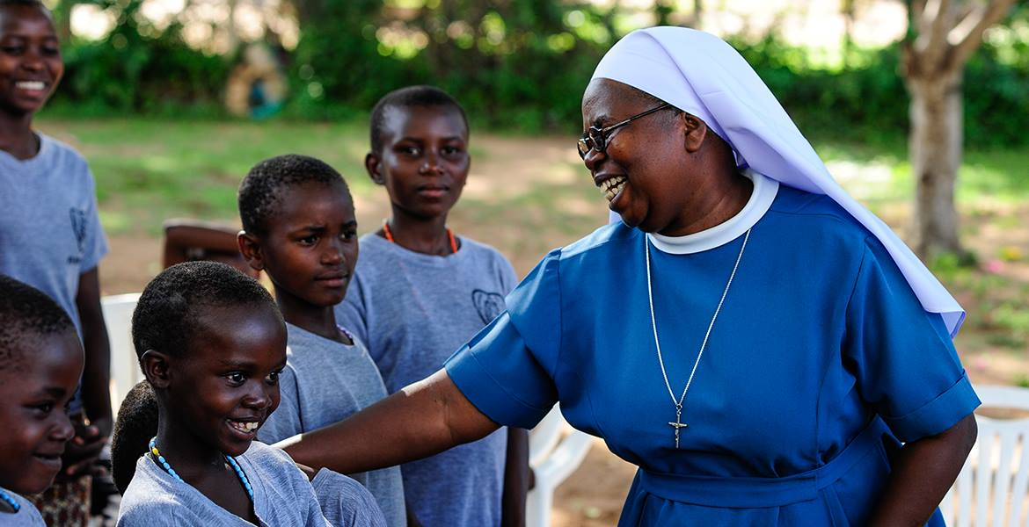
Missio and Social Justice
“In the same way faith, if good deeds do not go with it, is quite dead.”
James 2: 15-16

Slide 2
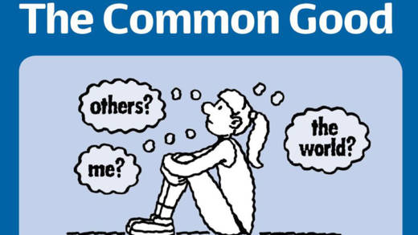
Missio and Social Justice
Catholic Social Teaching is based on the belief that God has a plan for creation, a plan to build His kingdom of peace, love and justice. It holds that God has a special place in this story for each of us, whoever we are. Our part in this plan isn’t just limited to things ‘spiritual,’ or things we might do on Sundays, but that it involves every aspect of our lives, from the things we pray about, to how we live as responsible global citizens.

Slide 3
Missio and Social Justice
Catholic Social Teaching touches upon many different aspects of life, from the family to international development, how we think of those who are homeless to how we care for the environment, and from how we shop and consume to the rights of workers and the dignity of work. All the different areas that Catholic Social Teaching touches upon have developed from practical reflection on the realities of modern life in the light of the principles and themes of Catholic Social Teaching.
“Whenever our interior life becomes caught up in its own interests and concerns, there is no longer room for others, no place for the poor. God’s voice is no longer heard, the quiet joy of his love is no longer felt, and the desire to do good fades.”
Pope Francis, Evangelii Gaudium

Slide 4
Missio and Social Justice
Task A
Catholic Social Teaching is based on what belief?
What area of Catholic Social teaching do you think is the most important issue in Scotland, at the moment, and why?
Do you think that we have a responsibility to help those who are homeless? Explain.
Do you think that we have a responsibility to care for the environment? Explain.
Do you think that people have a right to be treated in a certain way by their employers? Explain
Do you agree with Pope Francis that if a person starts to care only about themselves then the ‘desire to do good fades’?
Imagine that you could achieve the 17 goals on poverty. List them in order of importance i.e. would you ensure clean water before affordable energy?

Slide 5
Missio and Social Justice
Use the data from the Scottish Government to create a table showing how poverty affects different people within Scottish society.

Slide 6
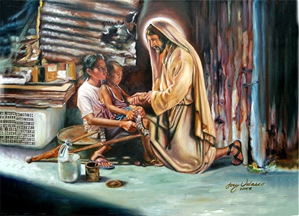
Missio and Social Justice
Jesus reveals three important truths about the nature of God to us:
Jesus reveals that God loves all people.
Jesus reveals that God forgives His people and offers them mercy and compassion.
Jesus reveals that God is on the side of the poor and vulnerable.
When there is a question of protecting the rights of individuals, the poor and helpless have a claim to special consideration. The rich population has many ways of protecting themselves and stands less in need of help. Rerum Novarum, Paragraph 29
Task: See-Think-Wonder
Write down one thing you see, one thing you think and one thing you wonder about the above image.

Slide 7
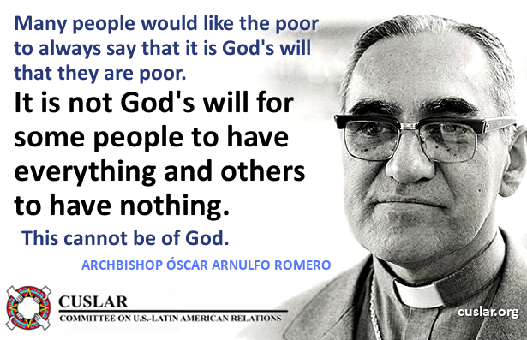
Missio and Social Justice
Oscar Romero was born on August 15, 1917, in Ciudad Barrios, a small mountain village in the country of El Salvador in South America. Oscar’s father was a postman and Oscar himself became an apprentice joiner at the age of 13. Later, however, he trained to be a priest and was ordained in 1942.

Slide 8
Missio and Social Justice
At that time, El Salvador was suffering from serious injustices. Most of the country’s wealth was owned by a few very rich families. They lived in big houses on huge estates and employed many servants. Nearby, the poor lived in houses made of cardboard and corrugated iron with neither running water nor electricity. The country was ruled by a military dictatorship and the rulers were supported by the wealthy families.
Whenever there was an attempt to improve the conditions of the poor, it was put down by force. After working in a parish, Oscar Romero became secretary to the bishop, and then in 1977 became Archbishop of San Salvador, the capital city. At first, he appeared to be a shy, quiet, timid person. Soon, however, his image was to change, and he became someone who was deeply involved in the fight for justice for the poor.

Slide 9
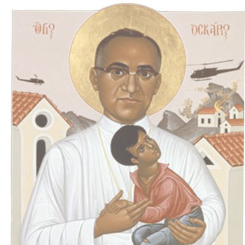
Missio and Social Justice
At that time, many ordinary priests were sympathetic to the poor and because of this they were murdered, tortured and persecuted by the authorities. Fr Rutilia Grande, a close friend of Archbishop Romero, was shot along with an old man and a boy while travelling to the village of El Paisnal to celebrate Mass.
This incident made a deep impression on Bishop Romero… He demanded explanations from the government for these events. He encouraged public demonstrations and opened his official residence to refugees and the hunted. He allowed a radio station to be set up in his office which broadcast details of the government’s injustice.
Every Sunday during Mass, which was also broadcast live, Archbishop Romero preached about the rights of the poor. However, he always urged people to protest peacefully, saying: “Only evil profits by murder.” Because of these words and actions 100 British MPs nominated him for the Nobel Peace Prize.

Slide 10
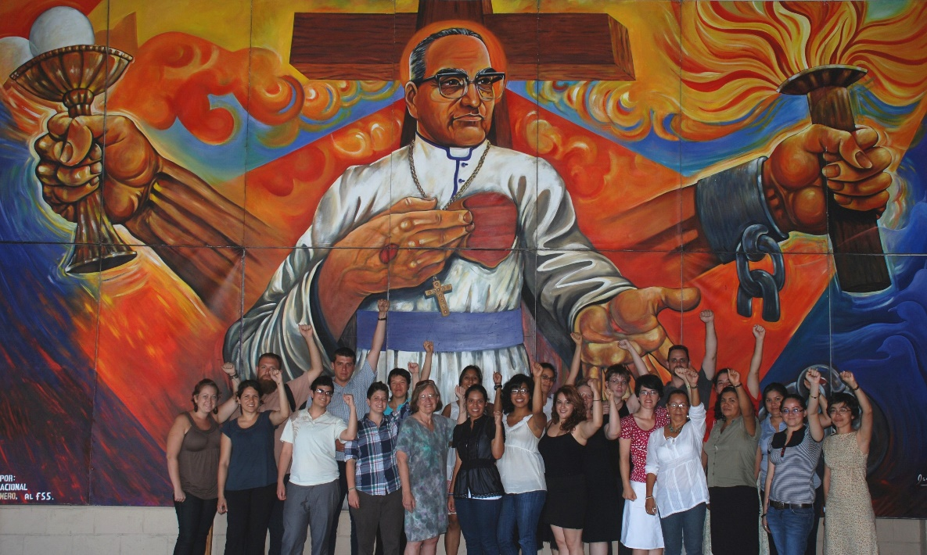
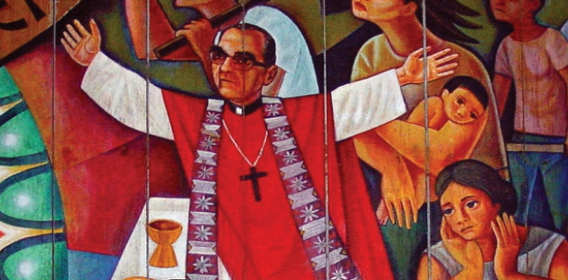
Missio and Social Justice
For some time before his death, he knew that his life was in danger. He said: “My life has been threatened many times. I have to confess that, as a Christian, I don’t believe in death without resurrection. If they kill me, I will rise again in the Salvadoran people. As a shepherd I am obliged to give my life for those I love, for the entire Salvadoran people, including those who threaten to assassinate me.”
On March 24, 1980, he was celebrating Mass. The Gospel included the words: “Unless a grain of wheat falls into the ground and dies, it remains alone. If it dies, it brings forth much fruit.” At the consecration of the Mass, a shot rang out. Oscar Romero was hit in the stomach. He fell at the steps of the altar. He was taken into hospital but died a few minutes later. Before dying he was heard to say: “May God have mercy on the assassin.”
Pope Francis Canonised Romero on October 14, 2018.

Slide 11
Missio and Social Justice
Task B
What do Catholics believe that Jesus revealed about God and all people?
Do you agree that the poor deserve special consideration when it comes to receiving the help of others? Explain
Where was Oscar Romero born?
What event had a lasting impact upon Bishop Romero?
Why did many of the powerful people within the government dislike Bishop Romero?
Copy and complete the following paragraph:
Oscar demanded explanations from the _____________. He encouraged public demonstrations and opened his official residence to refugees and the hunted. He allowed a _________ station to be set up in his office which broadcast details of the government’s ___________. Every Sunday during Mass, which was also broadcast live, Archbishop Romero preached about the rights of the _________. However, he always urged people to protest peacefully, saying: “Only ________ profits by murder.”
Bishop Romero knew that he was putting himself in danger by standing up for the poor. Why do you think that he did this?
What does the word Canonised mean?
Do you think that Oscar Romero deserved to be made a saint?

Slide 12
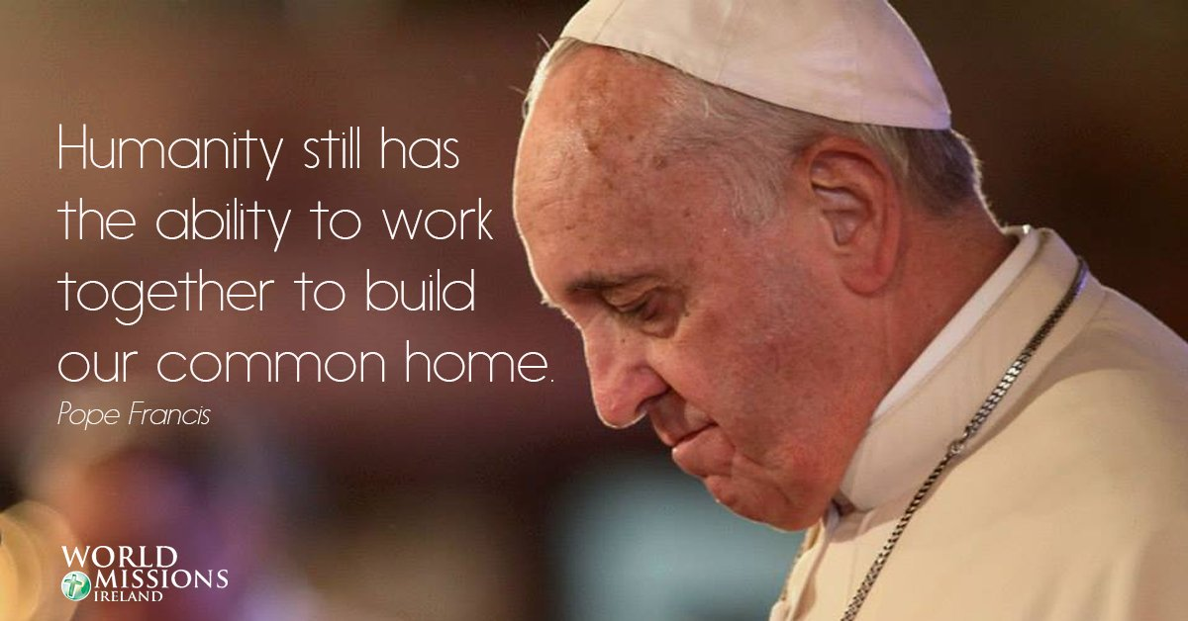
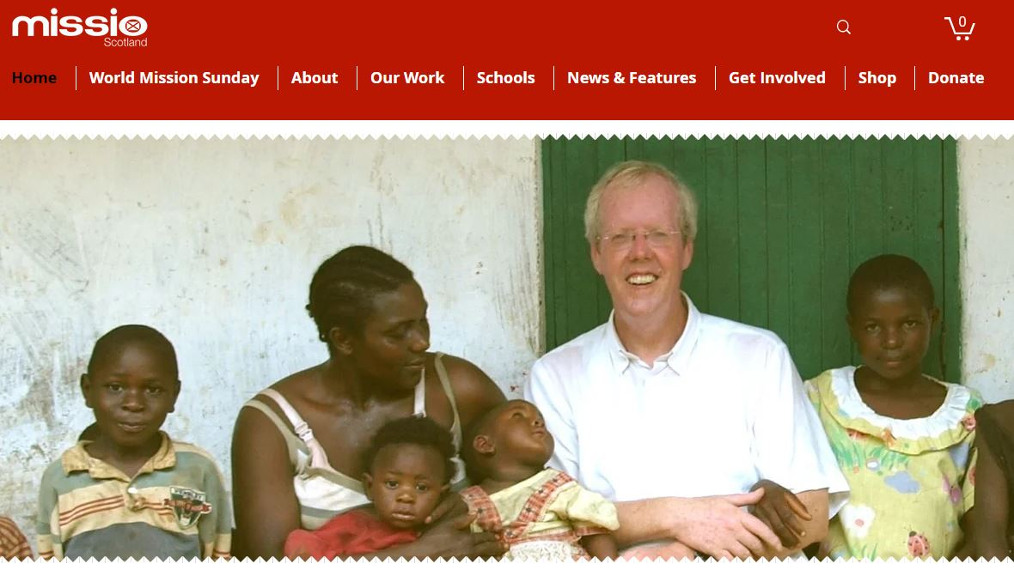
Missio and Social Justice
Missio Scotland and Social Justice
Missio Scotland is the Pope’s Charity for overseas missions and aims to continue the mission of Jesus Christ in the world to share faith, care for people in need and act for justice and creation. Missio funds projects all over the world to provide for those who are in need whether this be food, education, healthcare or religious education.
“The Spirit of the Lord is upon me, for He has anointed me. He has sent me to bring good news to the poor, to proclaim liberty to the captives and to the blind new sight, to set the downtrodden free, to proclaim the Lord’s year of favour.”
Luke 4: 18-19

Slide 13
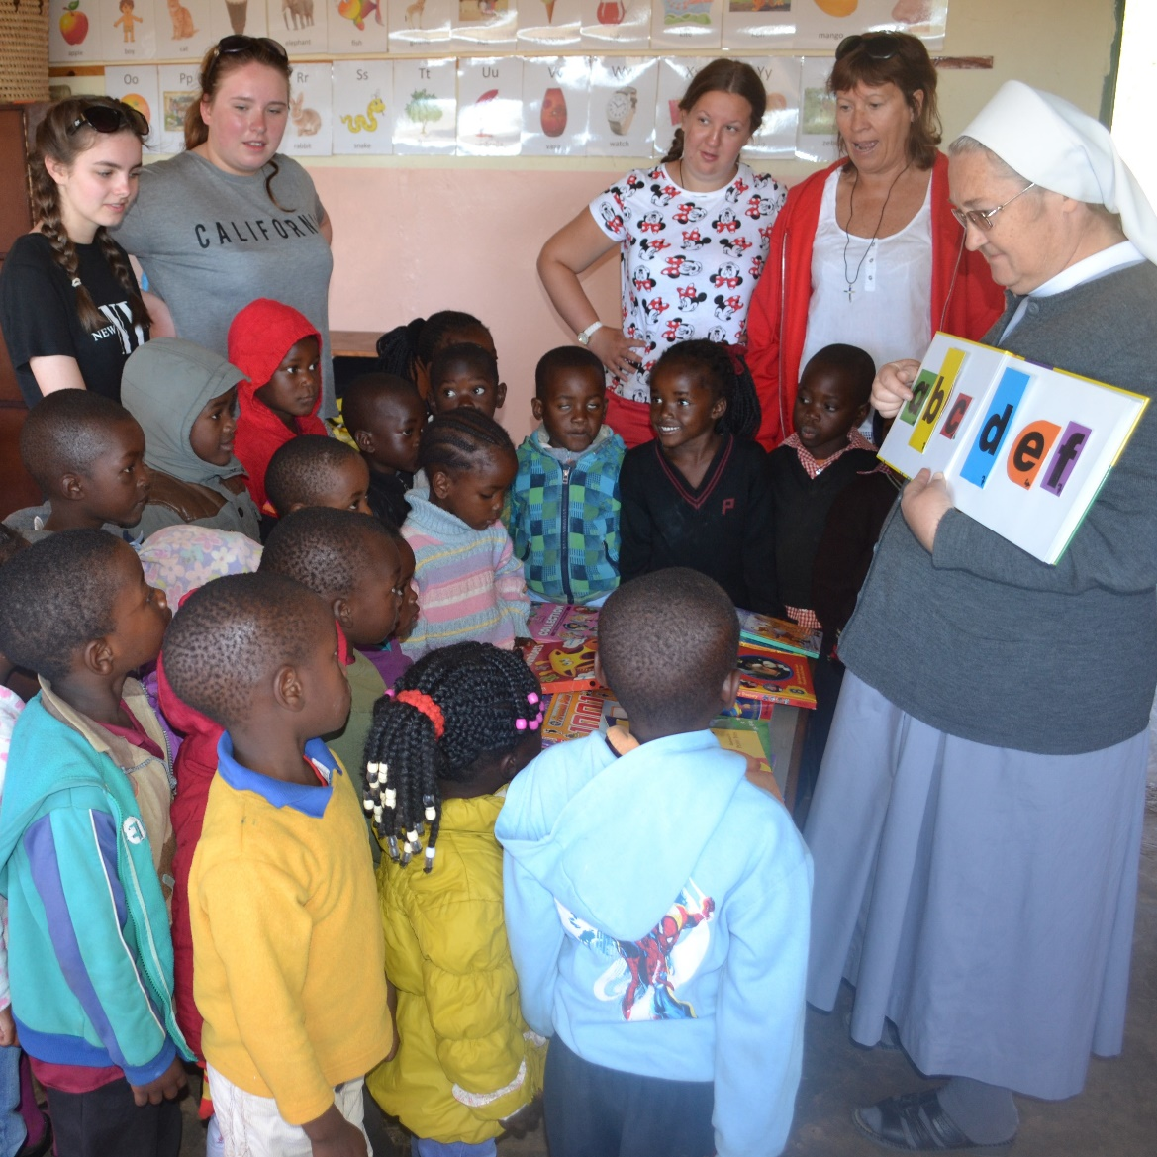
Missio and Social Justice
The central message of Christianity, to love God and love our neighbour as our self, is proclaimed most powerfully in selfless acts of love. This means that we are called to do good even when we don’t gain anything in return. By these acts, Christians are both signs and witnesses of Christ.
This witness is essential so that all will know Jesus as Saviour and fullness of life and come to believe in the teachings of Christ. There are many people who dedicate their lives to serving God. Some do this by leaving their home and committing themselves to serving others. Some people become priests and nuns, travel all over the world and help some of societies’ most vulnerable. These people are called missionaries and many of them are teachers, nurses and carers in countries that stretch from Brazil to the Philippines.

Slide 14
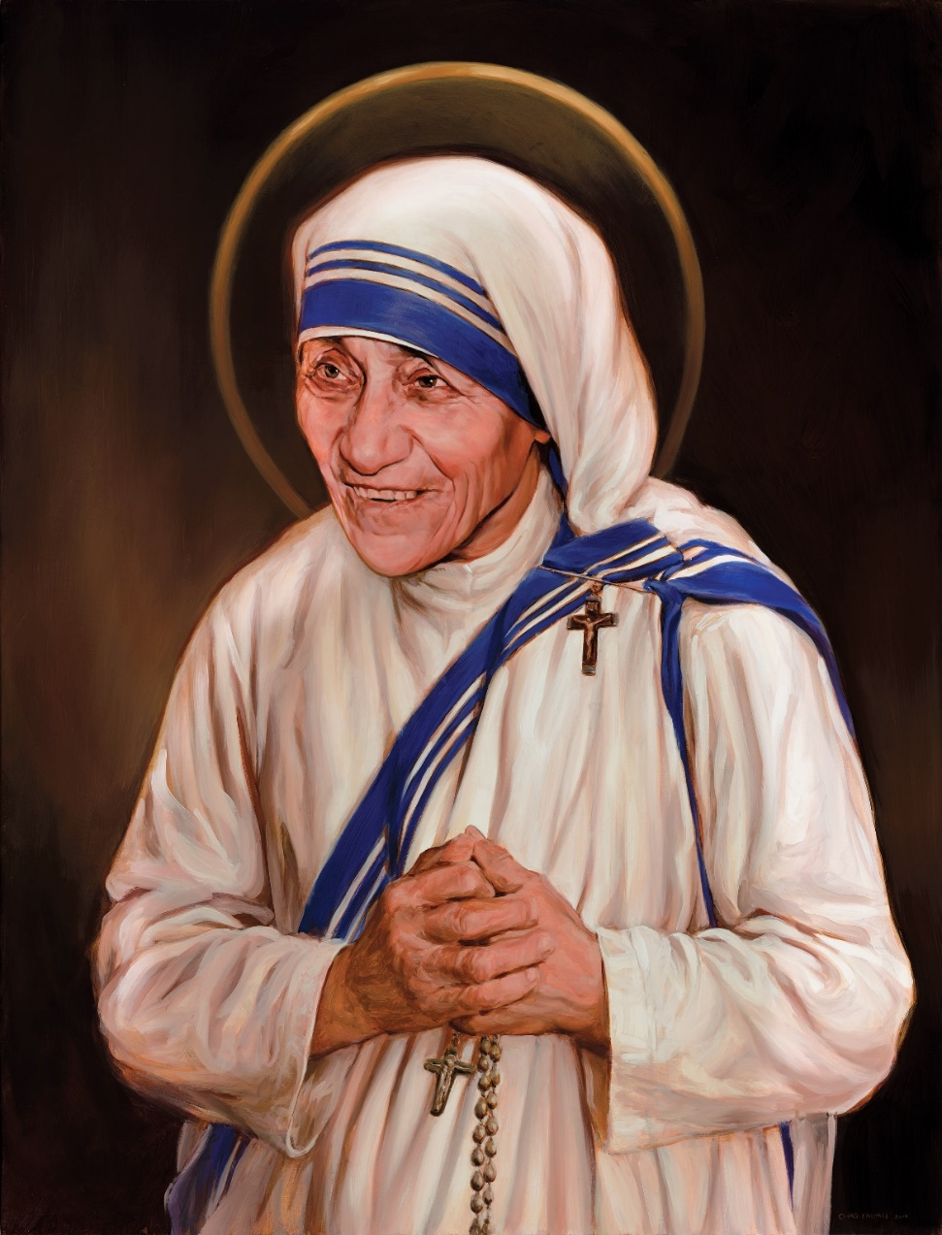
Missio and Social Justice
Mother Teresa was born in Skopje, Macedonia, on August 26, 1910. Her family was of Albanian descent. At the age of 12, she strongly felt the call of God. She knew she had to be a missionary to spread the love of Christ.
At the age of 18 she left her parental home and joined the Sisters of Loreto, an Irish community of nuns with missions in India. After a few months’ training in Dublin, she was sent to India, where on May 24, 1931, she took her initial vows as a nun. From 1931 to 1948 Mother Teresa taught at St Mary’s High School in Calcutta, India.
However, the suffering and poverty she glimpsed outside the convent walls made such a deep impression on her that in 1948 she received permission from her superiors to leave the convent school and devote herself to working among the poorest of the poor in the slums of Calcutta.

Slide 15
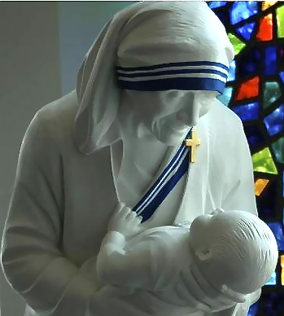
Missio and Social Justice
On October 7, 1950, Mother Teresa received permission from the Pope to start her own order, ‘The Missionaries of Charity,’ whose primary task was to love and care for the members of society that nobody was prepared to look after. Today the order comprises Active and Contemplative branches of Sisters and Brothers in many countries.
The Missionaries of Charity has spread all over the world, including the former Soviet Union and Eastern European countries. They provide effective help to the poorest of the poor in a number of countries in Asia, Africa, and Latin America, and they undertake relief work in the wake of natural catastrophes such as floods, epidemics, and famine, and for refugees. The order also has houses in North America, Europe and Australia, where they take care of the disabled, alcoholics, homeless, and AIDS sufferers.

Slide 16
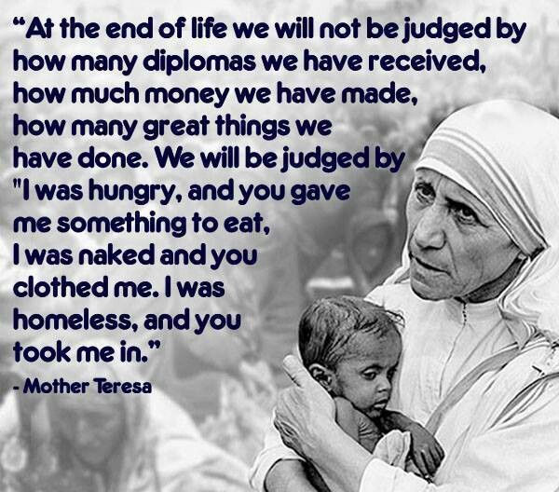
Missio and Social Justice
The Missionaries of Charity throughout the world are aided and assisted by co-workers who became an official International Association on March 29, 1969.
By the 1990s there were over one million co-workers in more than 40 countries. Mother Teresa died on September 5, 1997, in Calcutta, India.
Pope Francis declared Mother Teresa a saint on September 4, 2016, she is St Teresa of Calcutta.

Slide 17
Missio and Social Justice
Task D
When and where was Mother Teresa born?
In what country did Mother Teresa study to become a nun?
How did Mother Teresa spend her first years abroad in India?
Why did Mother Teresa leave the convent school?
In 1950 Mother Teresa asked the Pope for permission to do what?
The society that Mother Teresa established is called_____________.
By the time Mother Teresa died how many countries was her society working in?
When was Mother Teresa declared a saint?
What did Mother Teresa believe about how God would judge a person at the end of their life? Do you agree with her? Explain.
Create a timeline of Mother Teresa’s life.

Slide 18
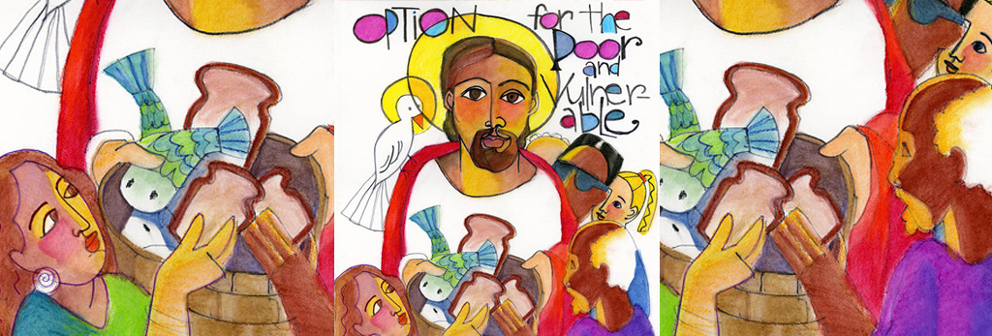
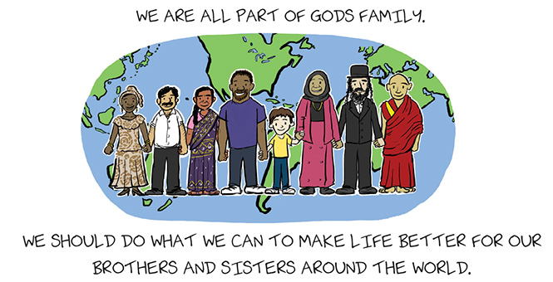
Missio and Social Justice

Slide 19
Missio and Social Justice
Use the Making Thinking Visible strategy to create a colour-symbol-image poster on Catholic Social teaching.
The Principles of Catholic Social Teaching
Dignity of the human person
Call to Family, Community, and Participation
Solidarity
Common Good
Option for the Poor and Vulnerable
Care for God’s Creation
The Dignity of Work and the Rights of Workers

